Slide 1
NOSQL Databases
Subramanian Murugan

Slide 2
Session Content
What is SQL
Advantages
Drawbacks

Slide 3
History

Slide 4
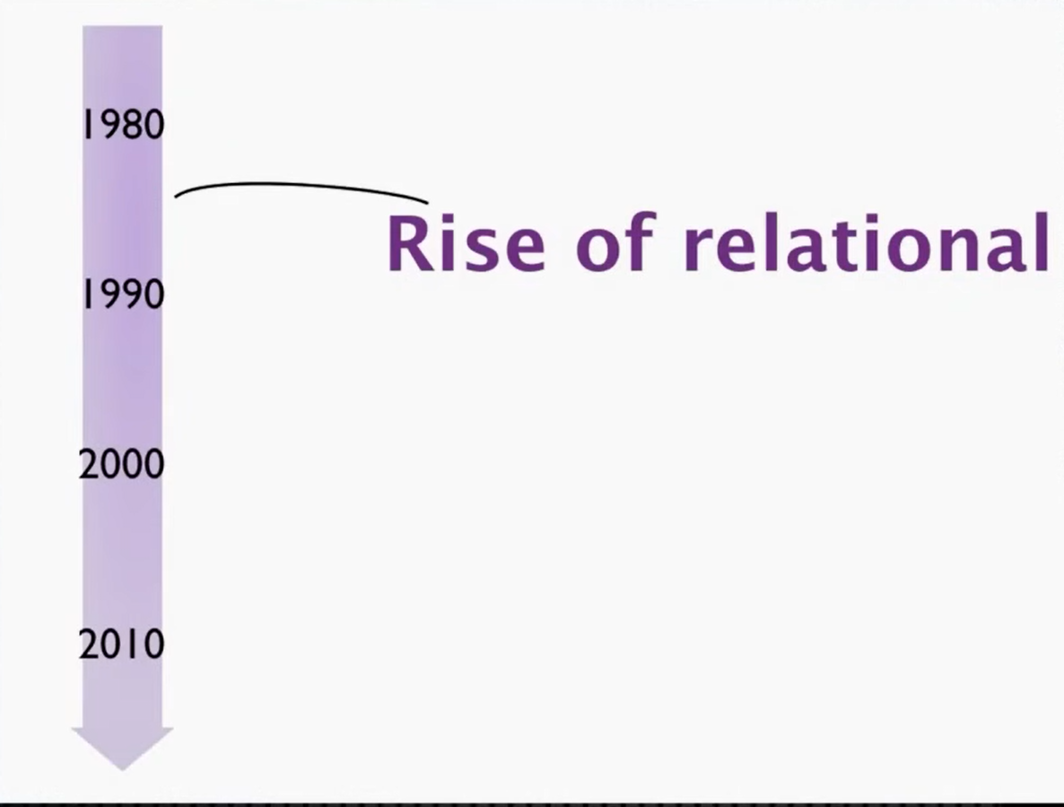

Slide 5
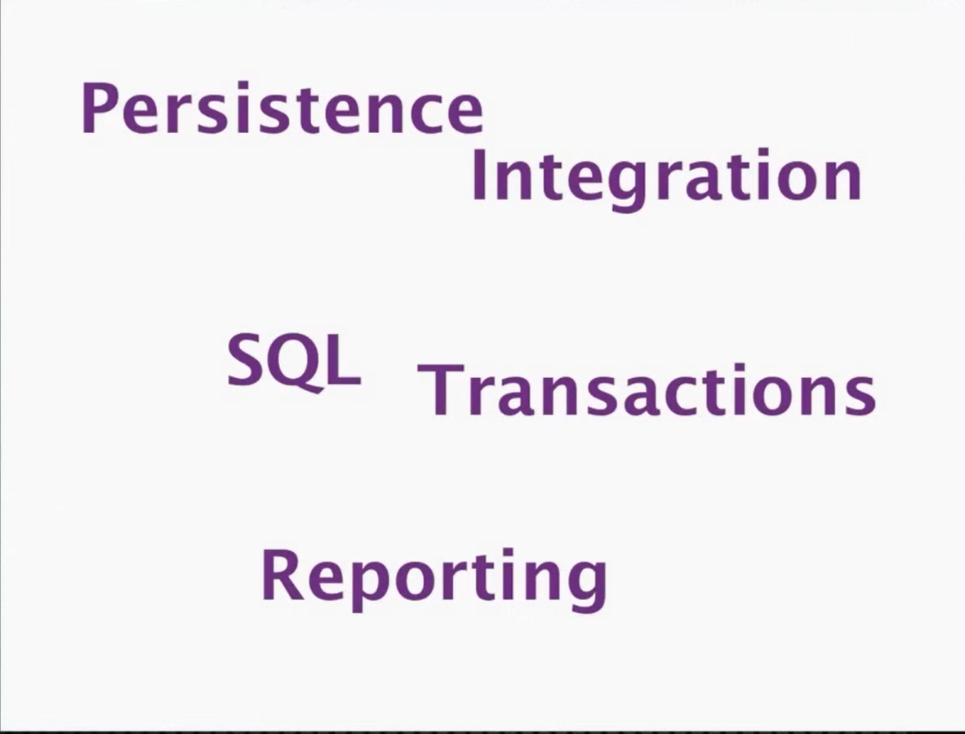

Slide 6
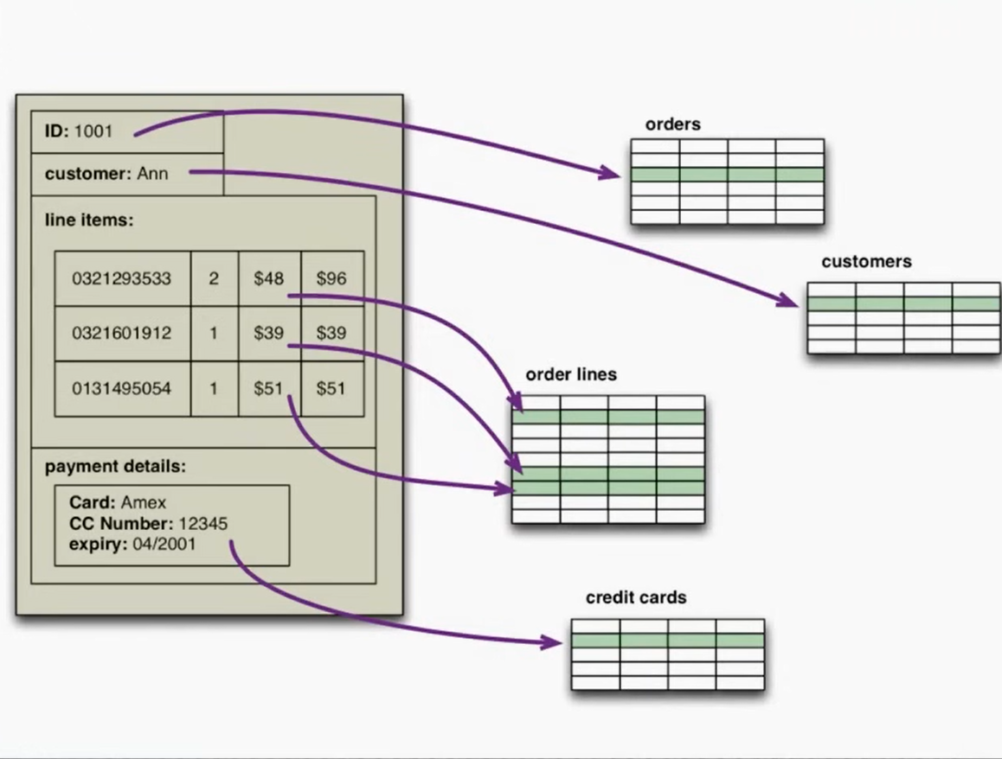

Slide 7
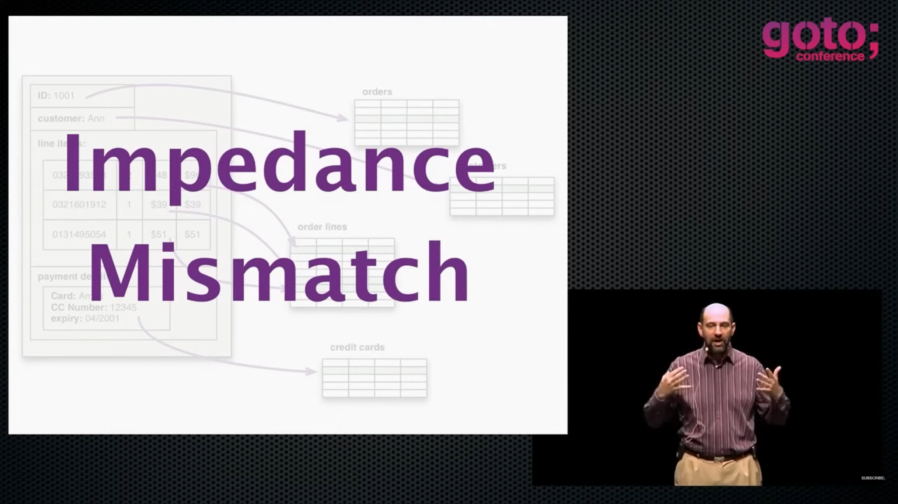

Slide 8
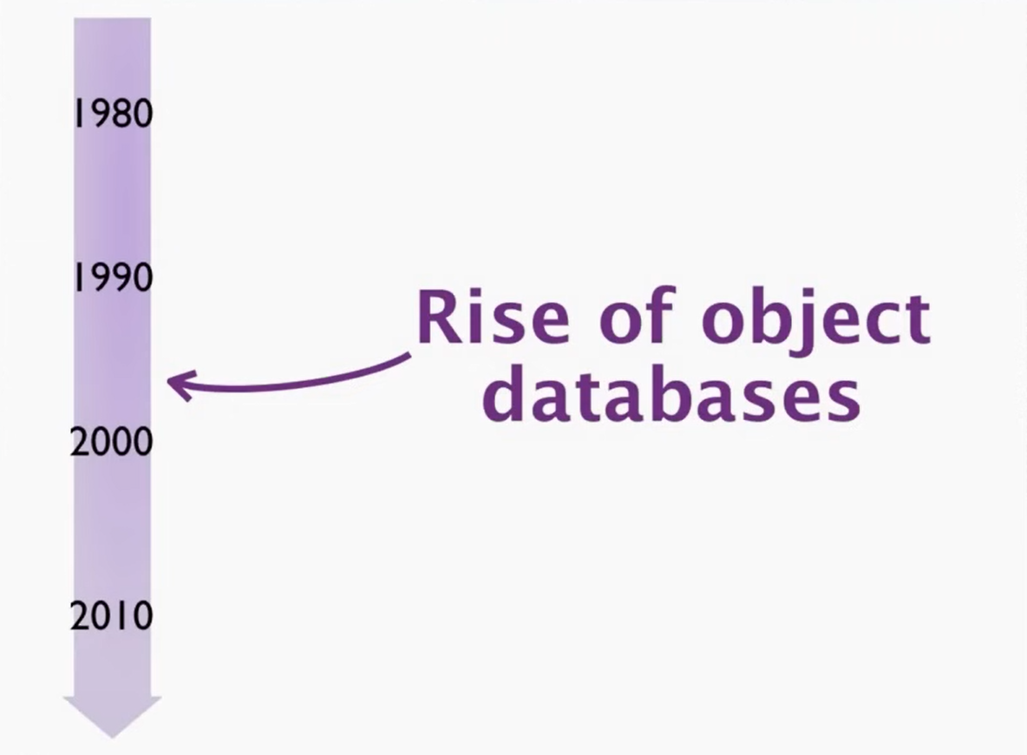

Slide 9
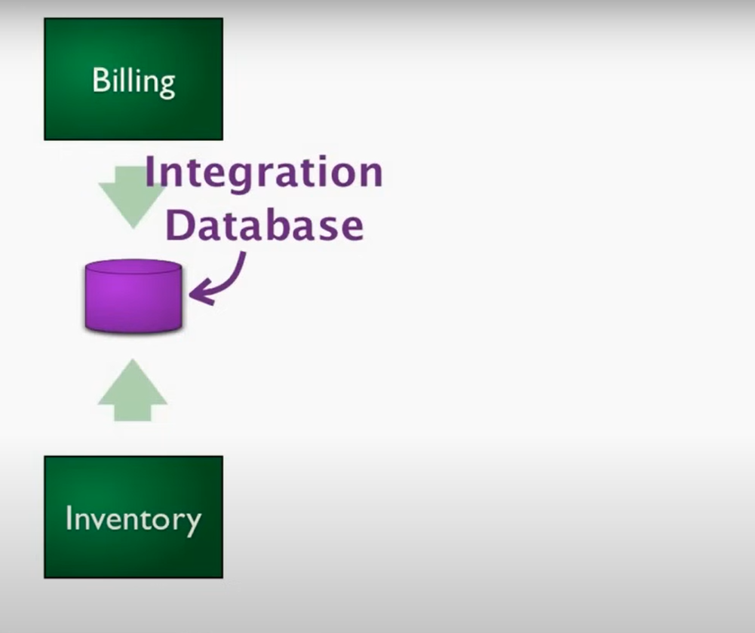

Slide 10
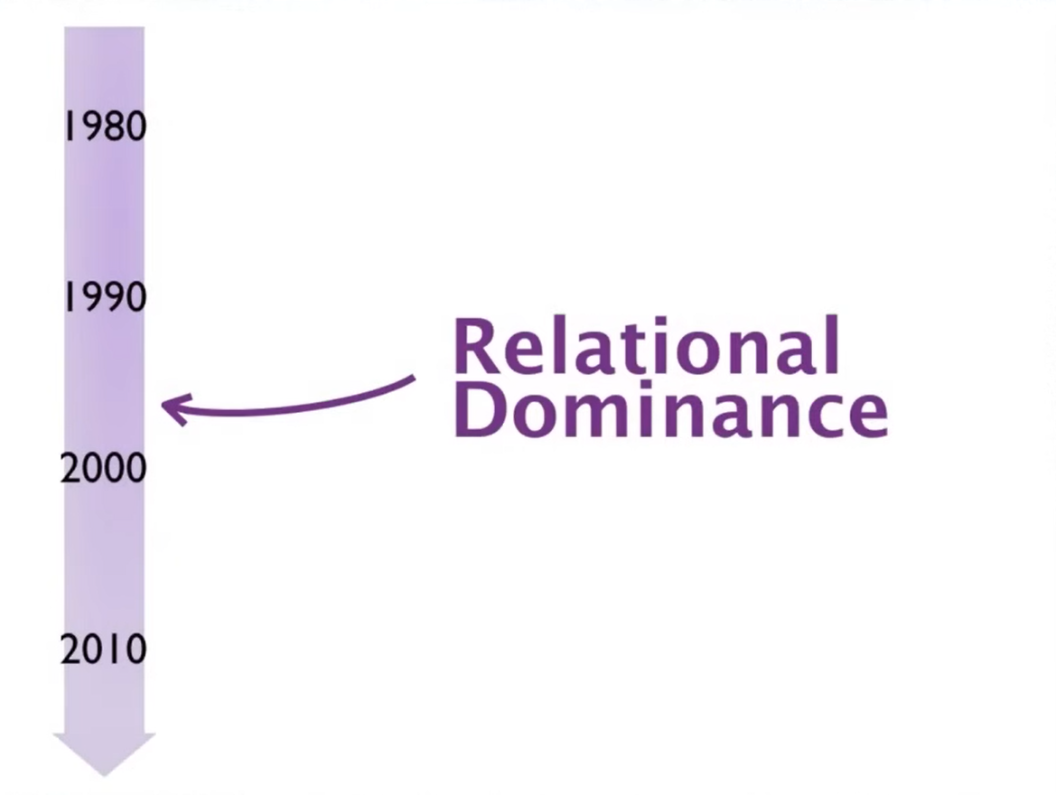

Slide 11
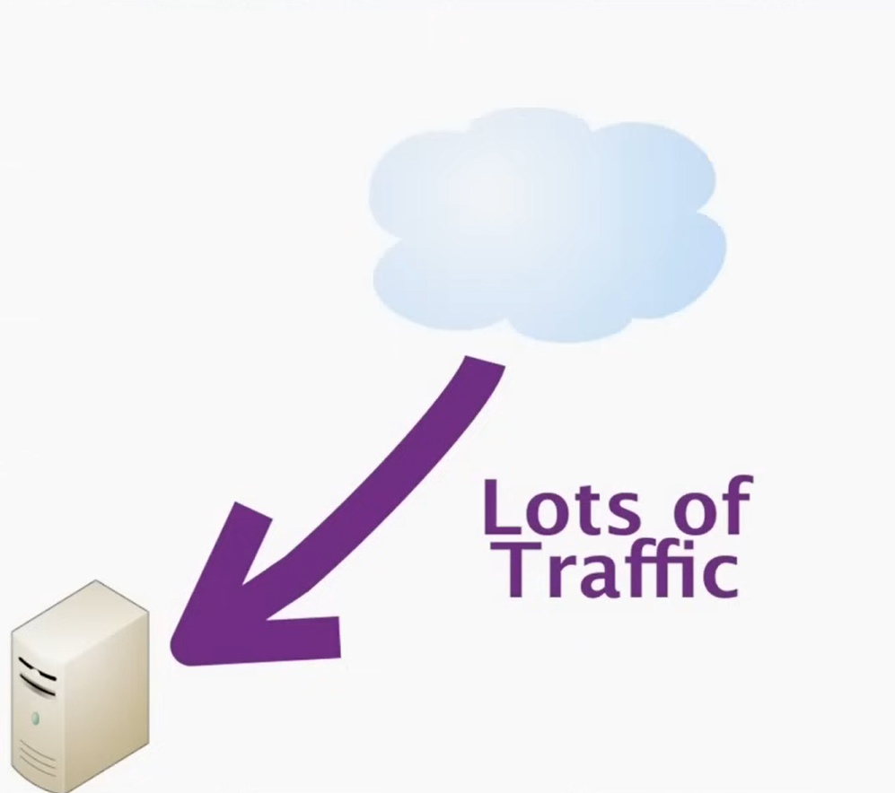

Slide 12
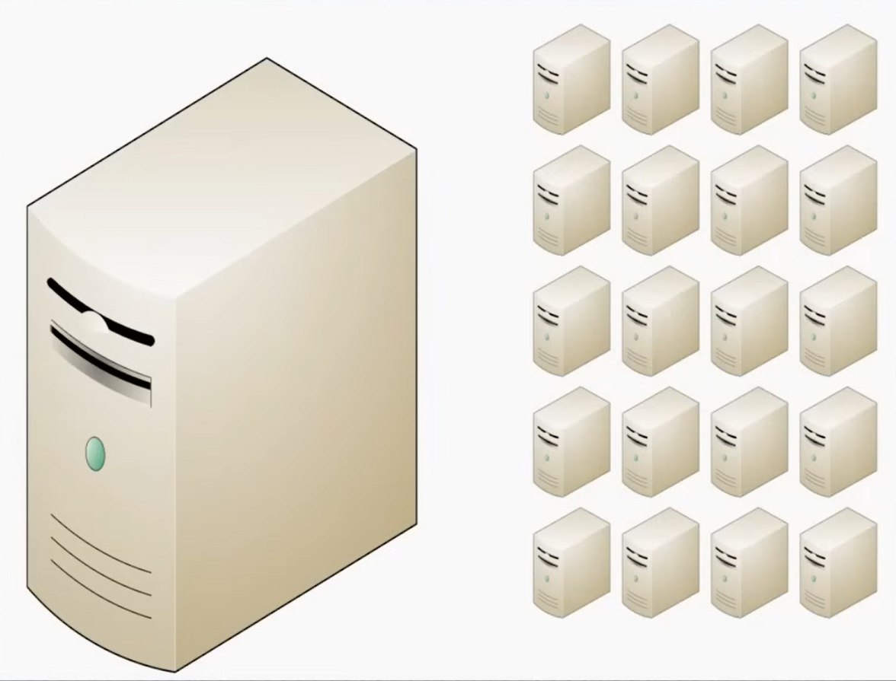

Slide 13
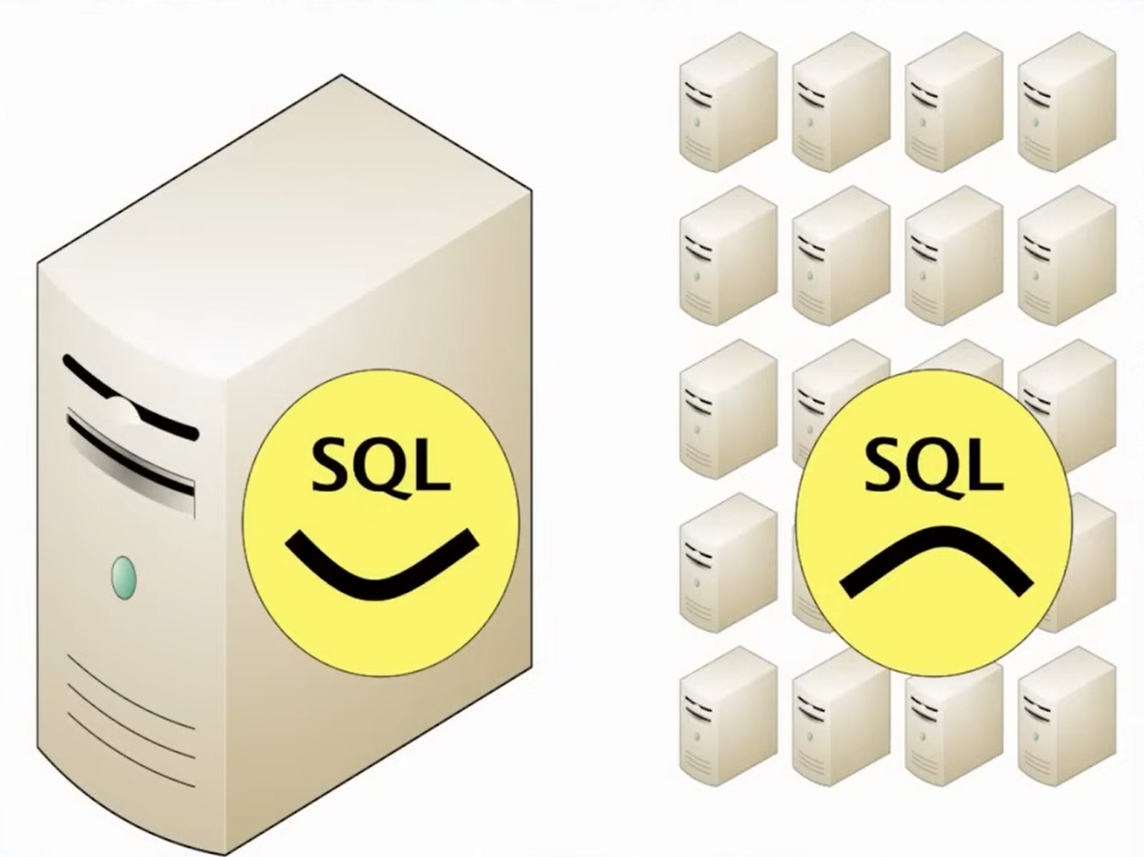

Slide 14
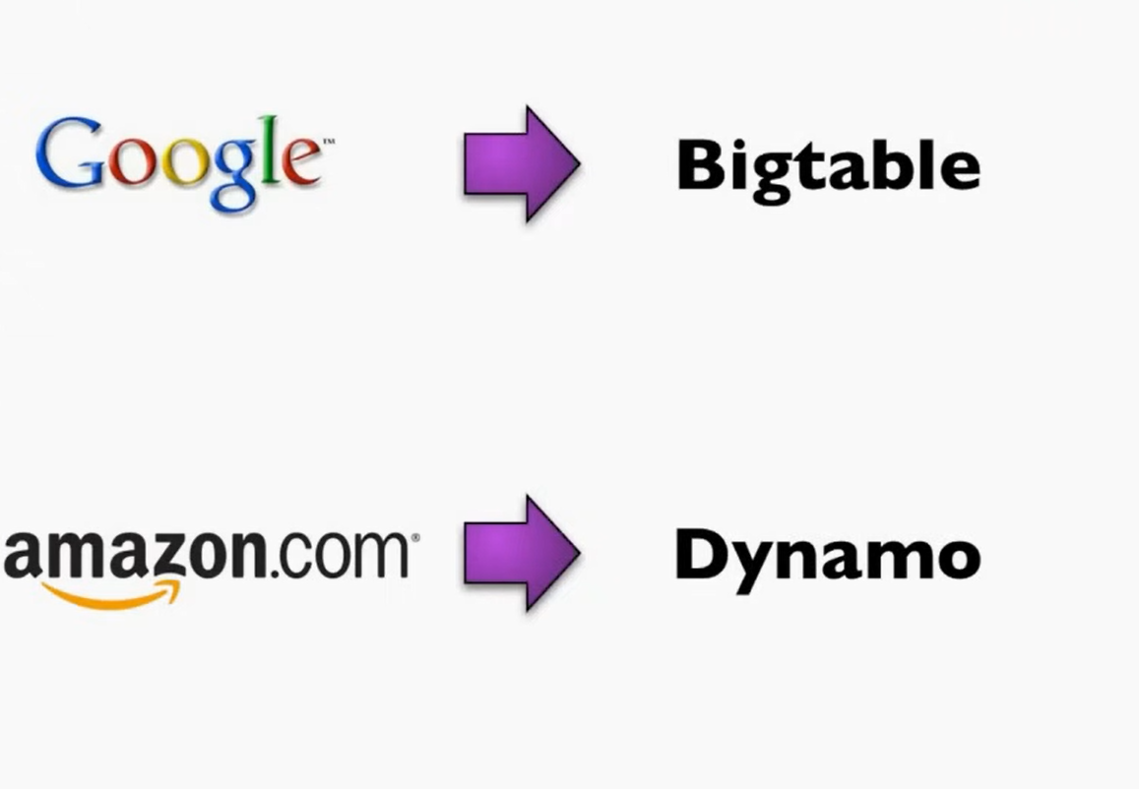

Slide 15
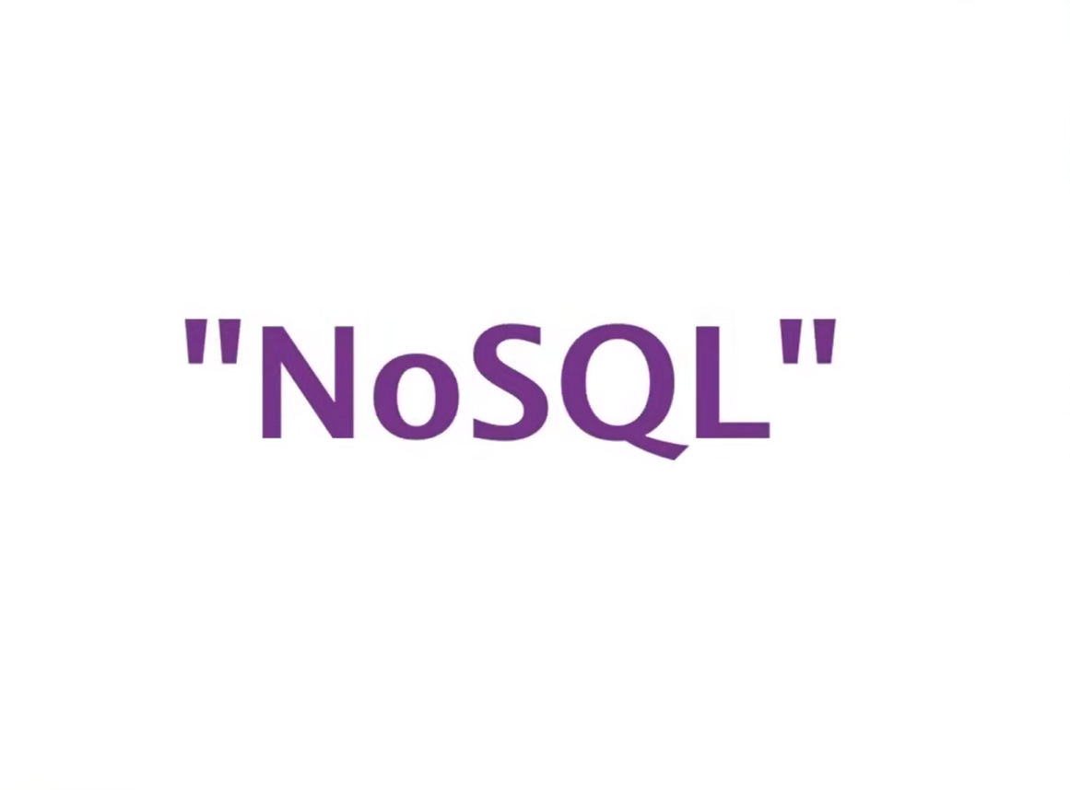

Slide 16
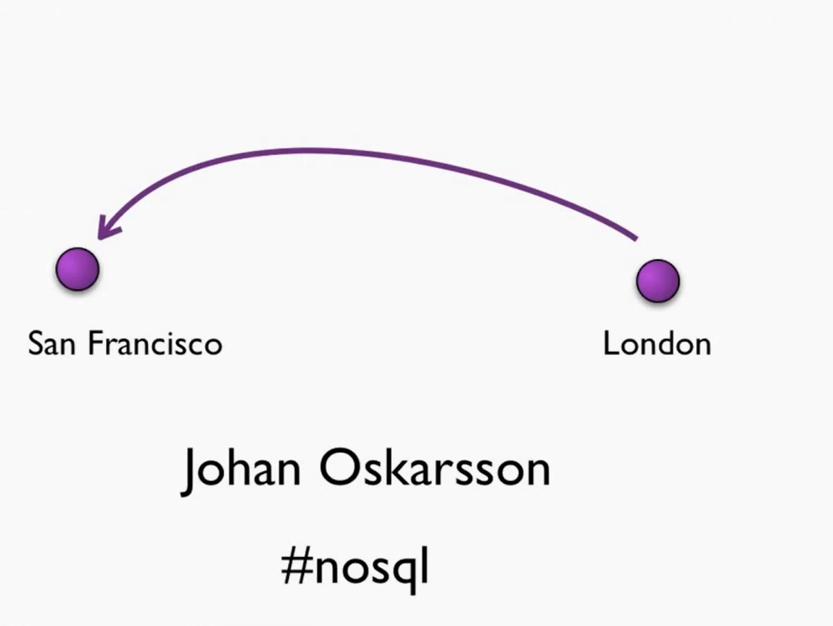

Slide 17
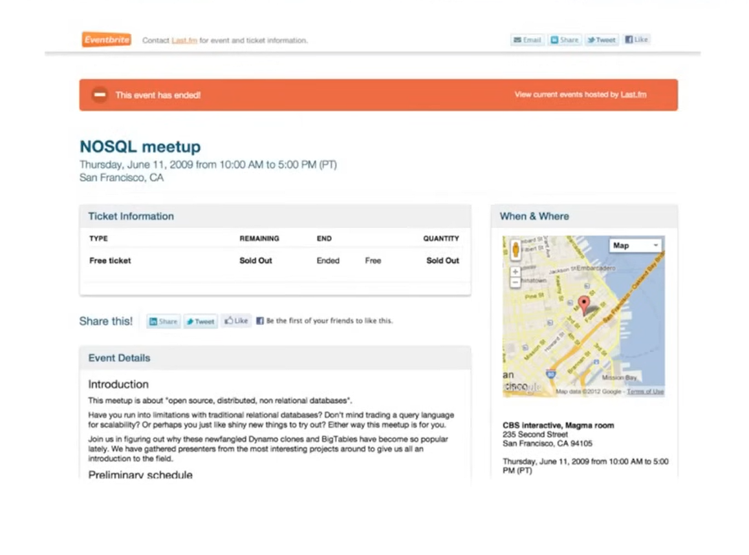

Slide 18
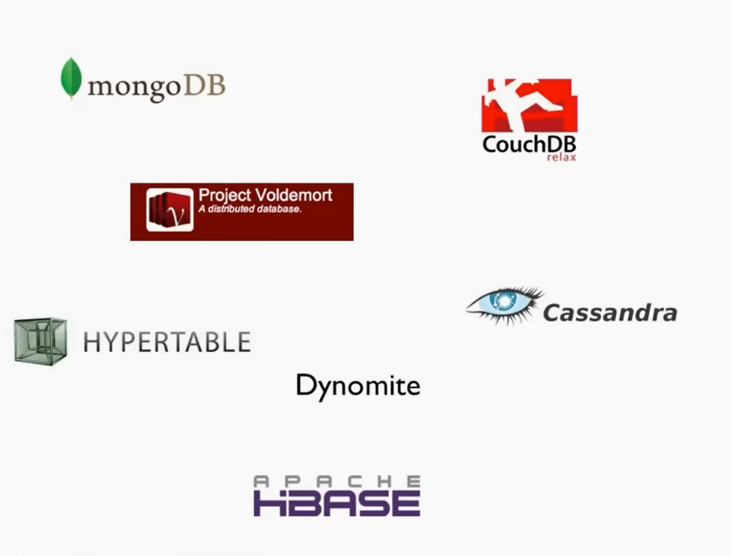

Slide 19
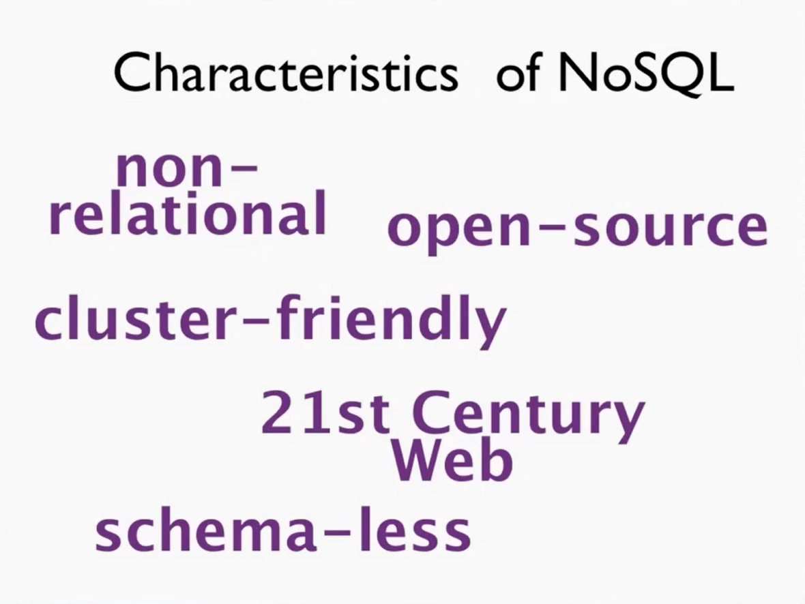

Slide 20
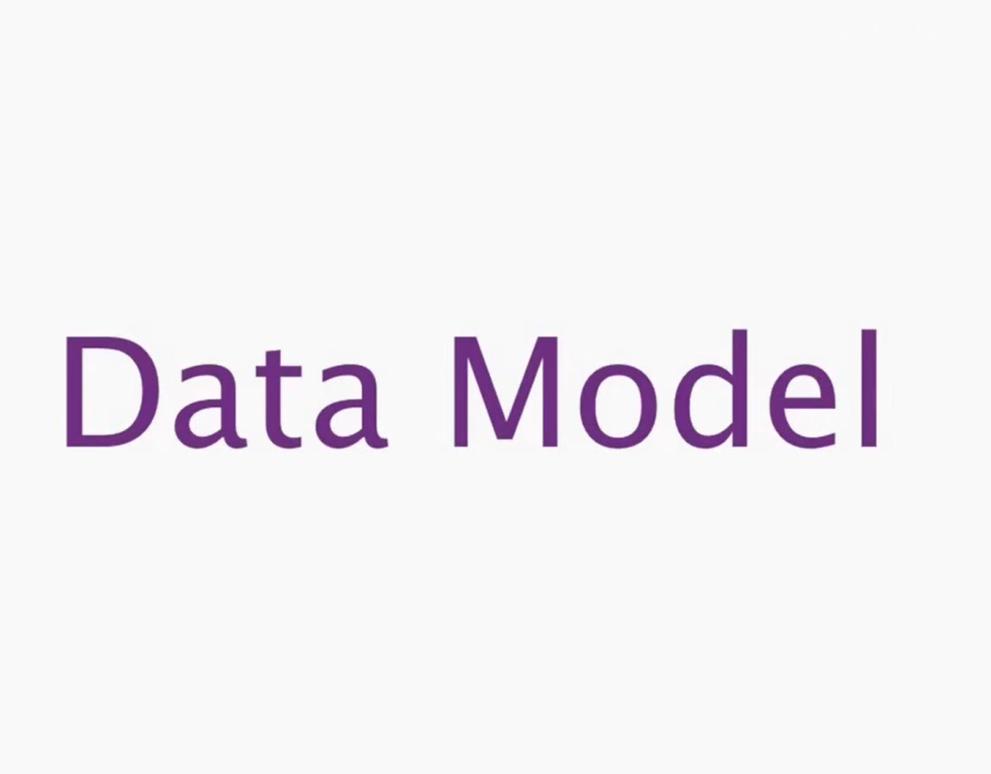

Slide 21
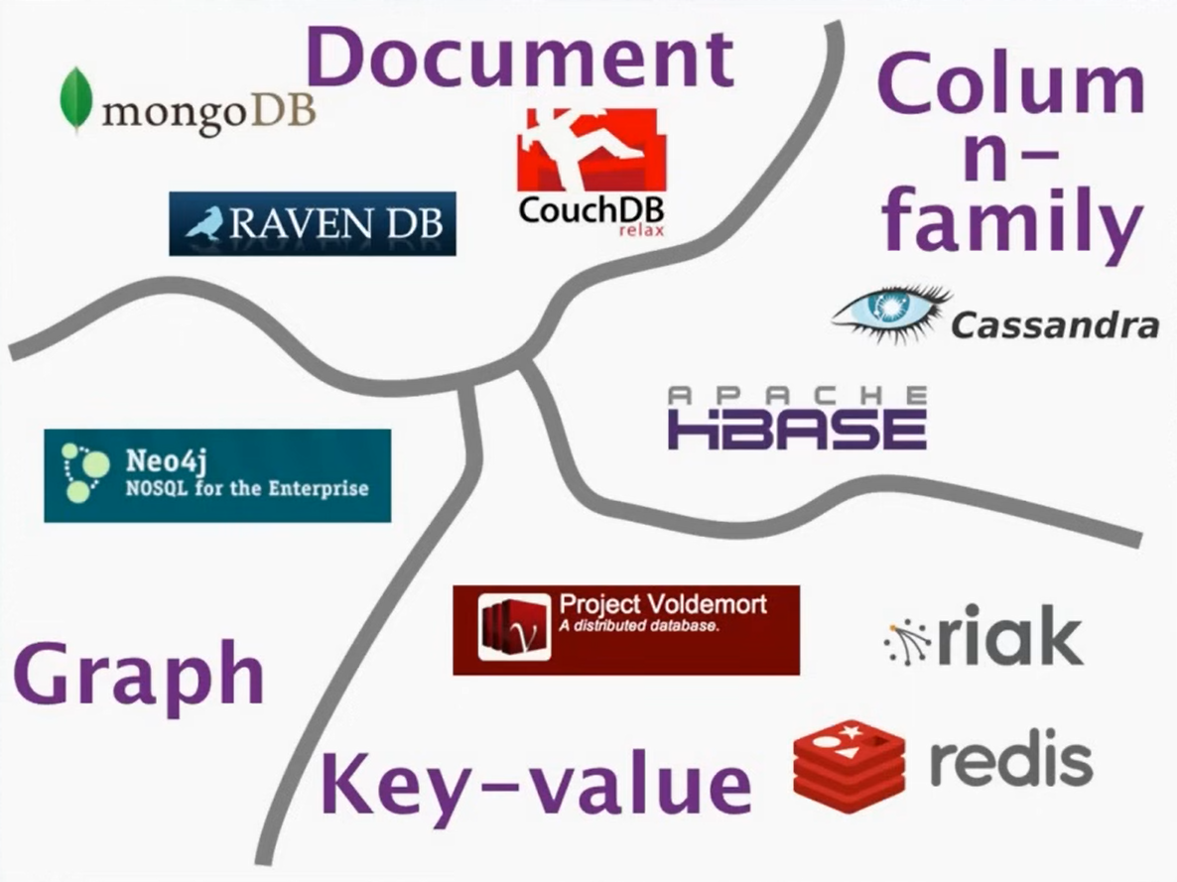

Slide 22
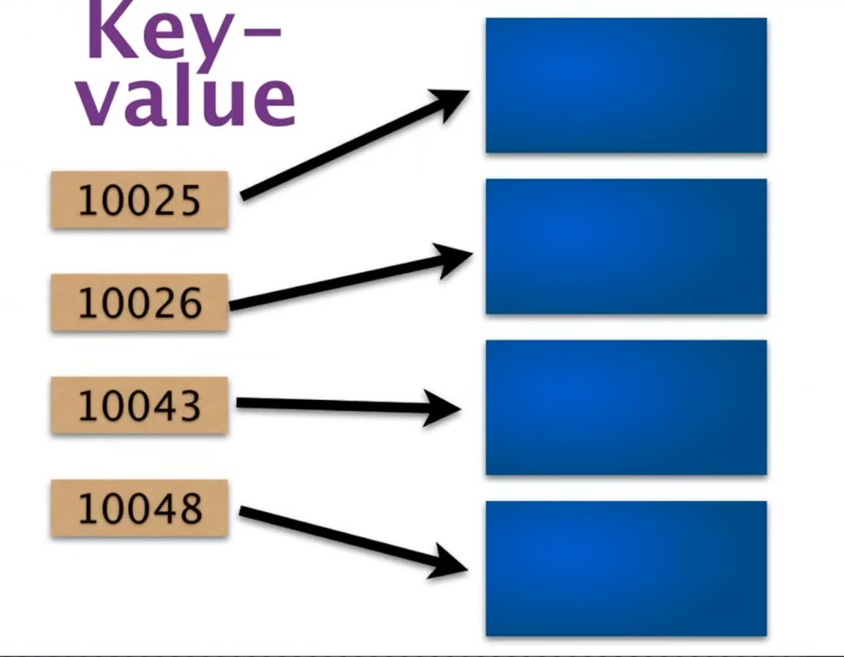

Slide 23
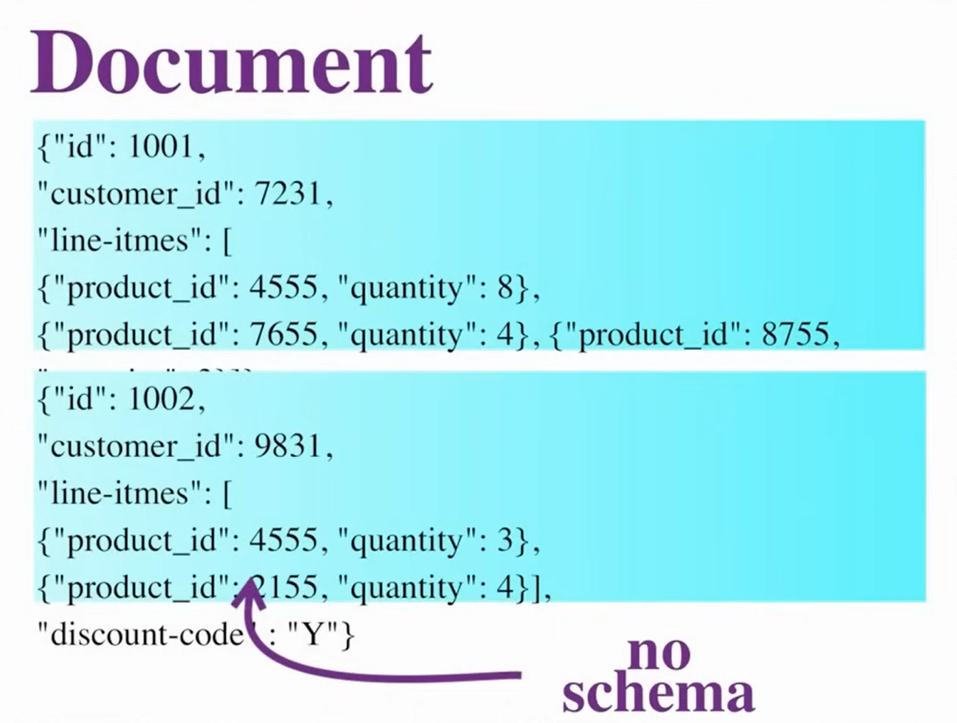

Slide 24
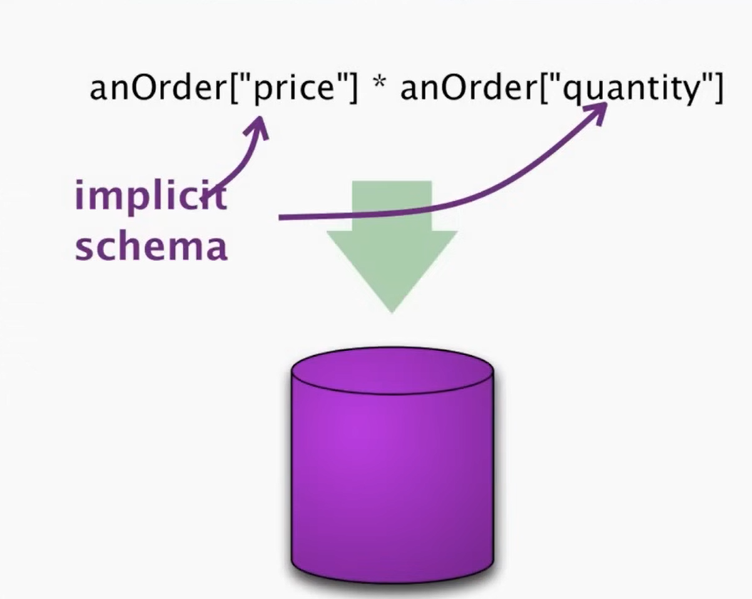

Slide 25
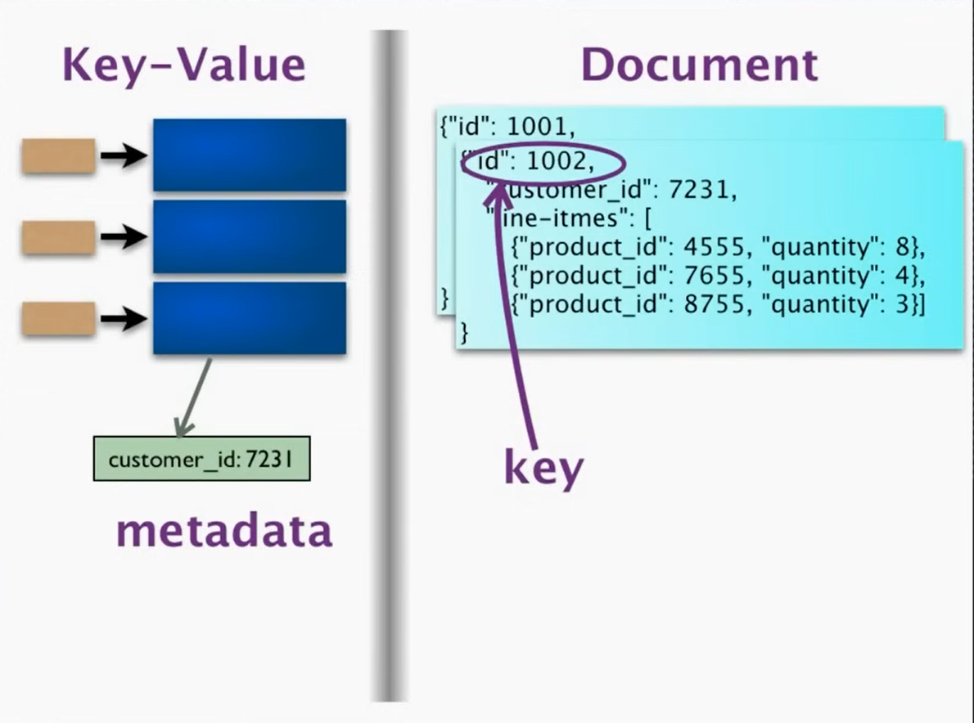

Slide 26
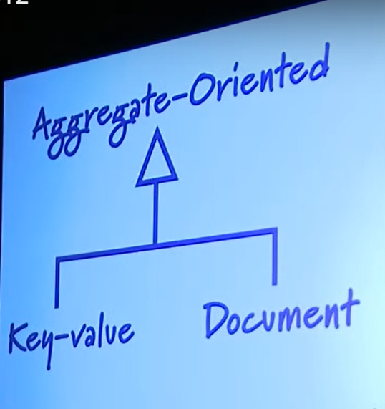

Slide 27


Slide 28
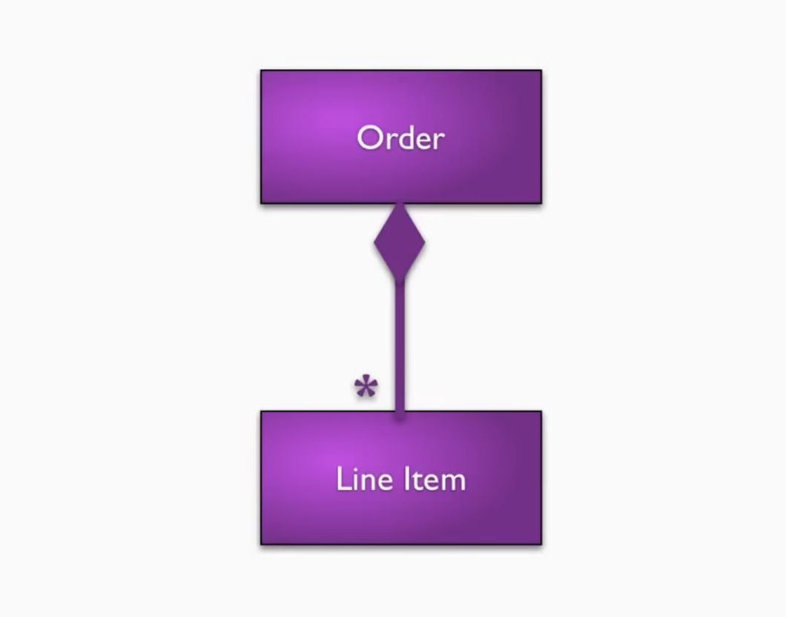

Slide 29
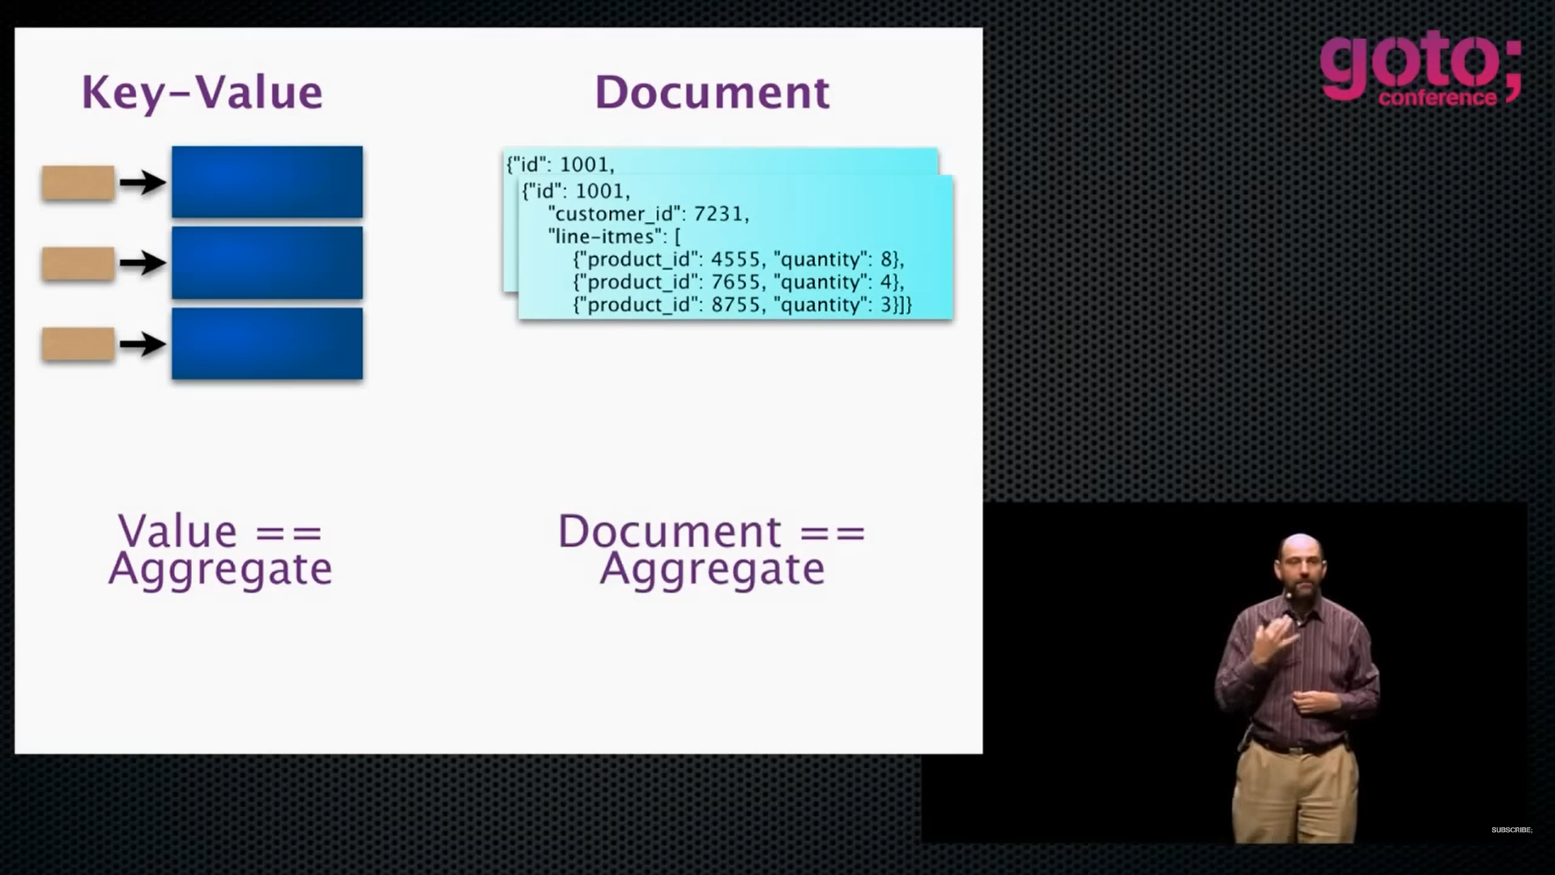

Slide 30
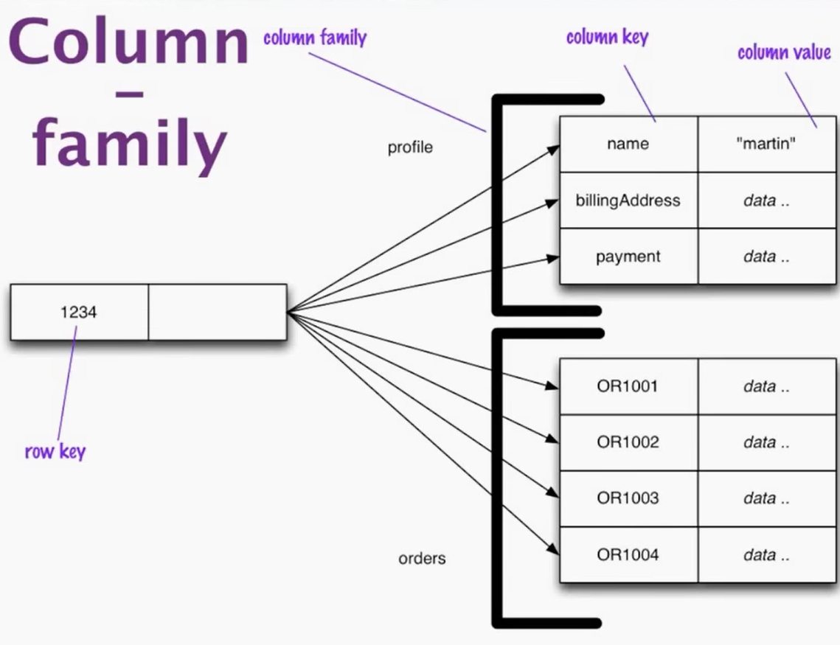

Slide 31
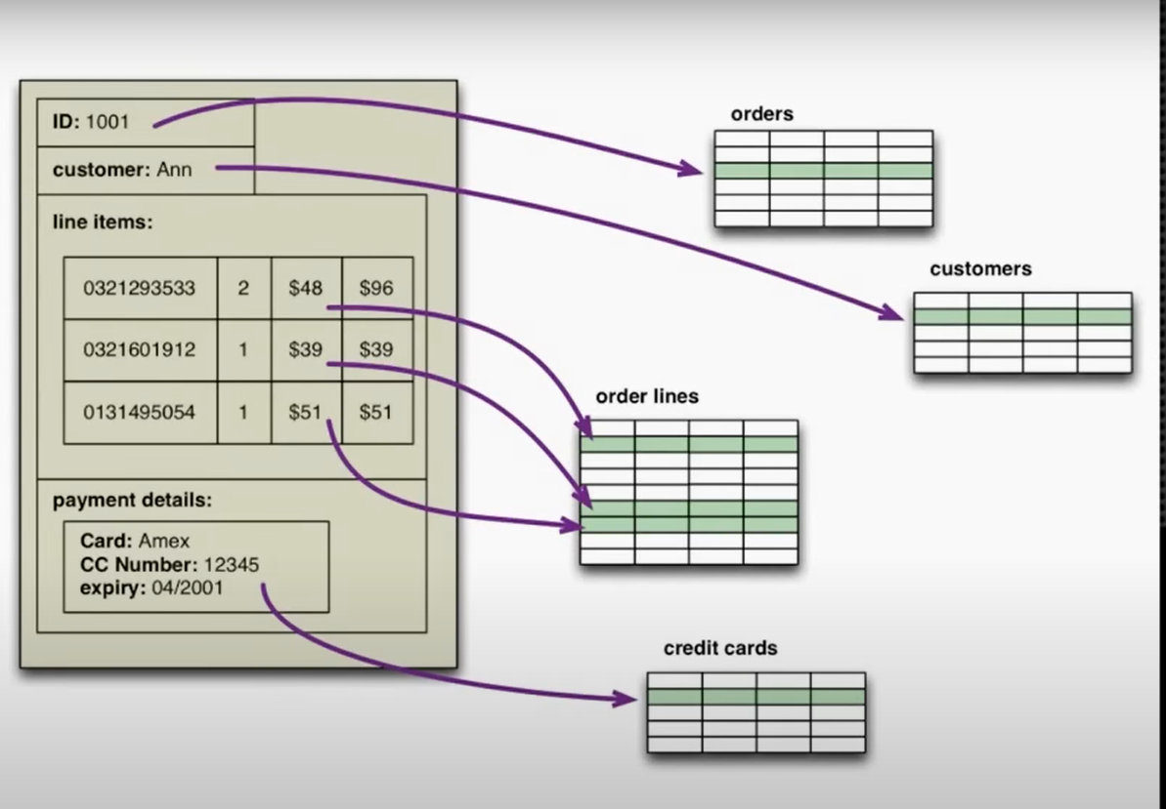

Slide 32
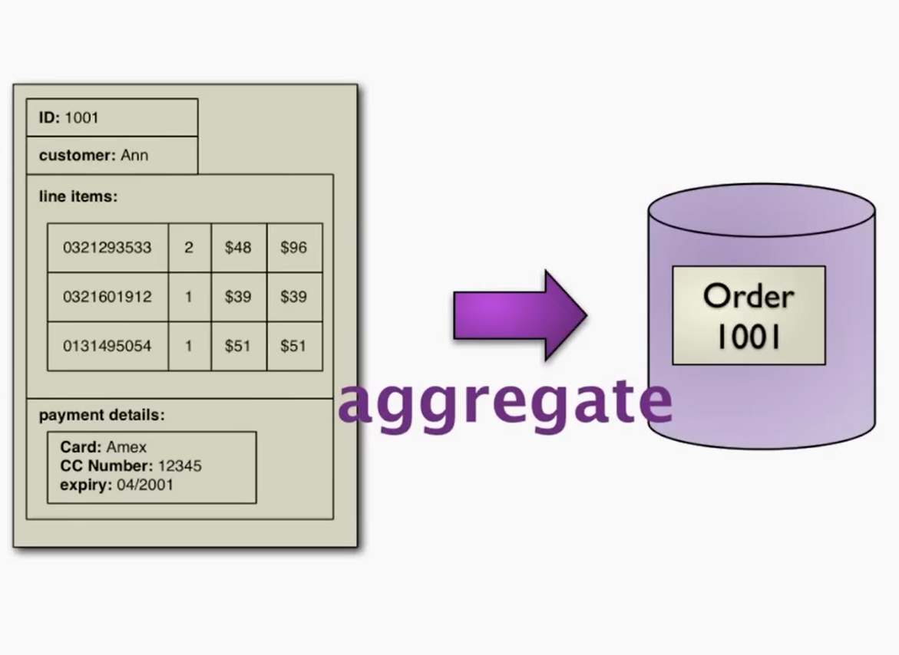

Slide 33
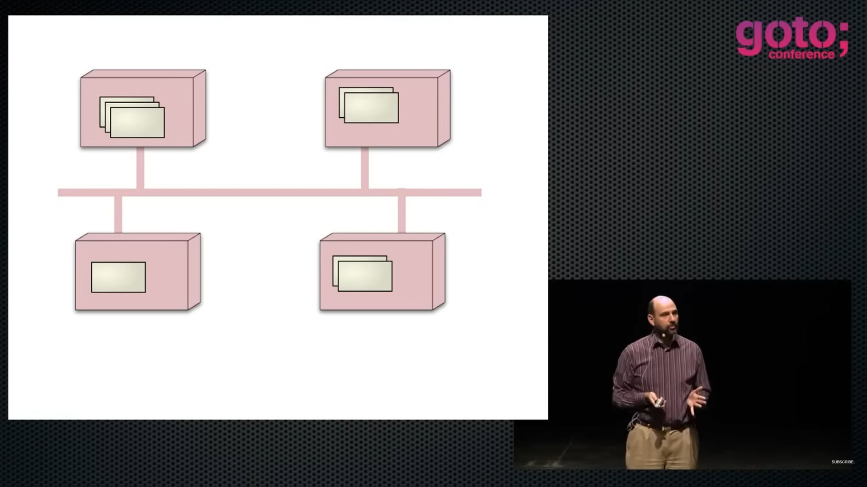
Aggregate distribution

Slide 34
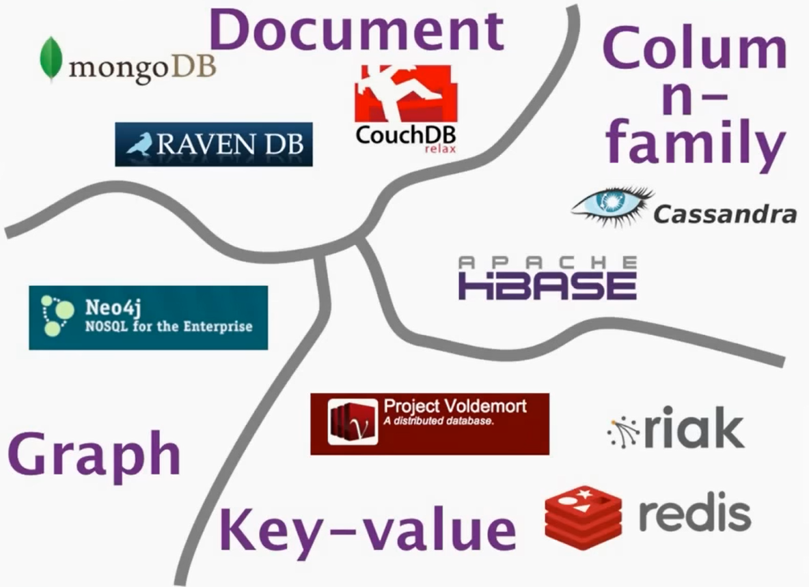

Slide 35
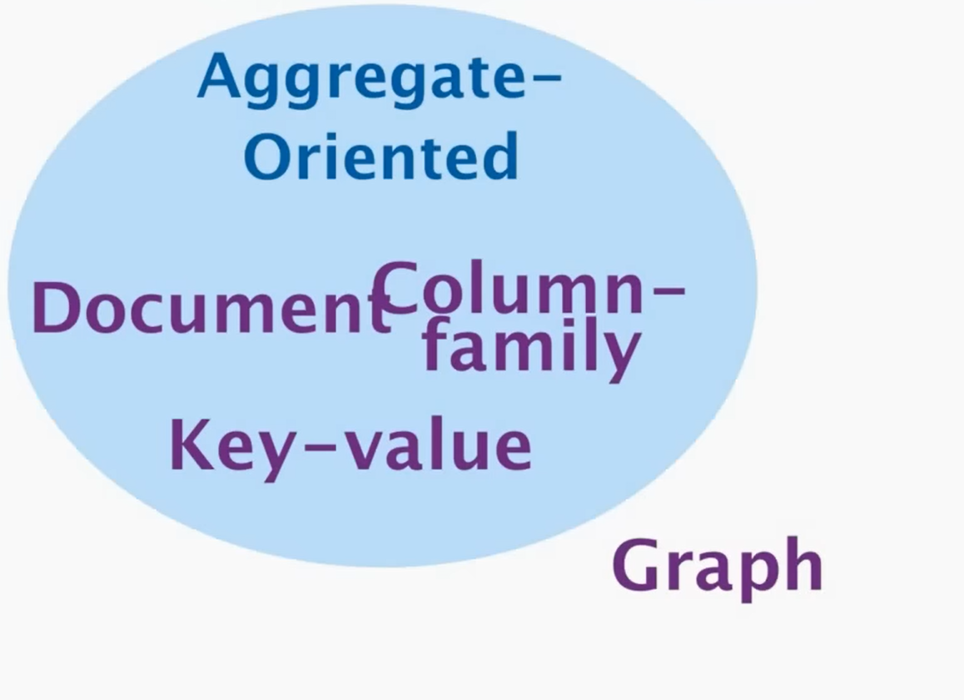

Slide 36


Slide 37


Slide 38

It is similar to JSON Document

Slide 39
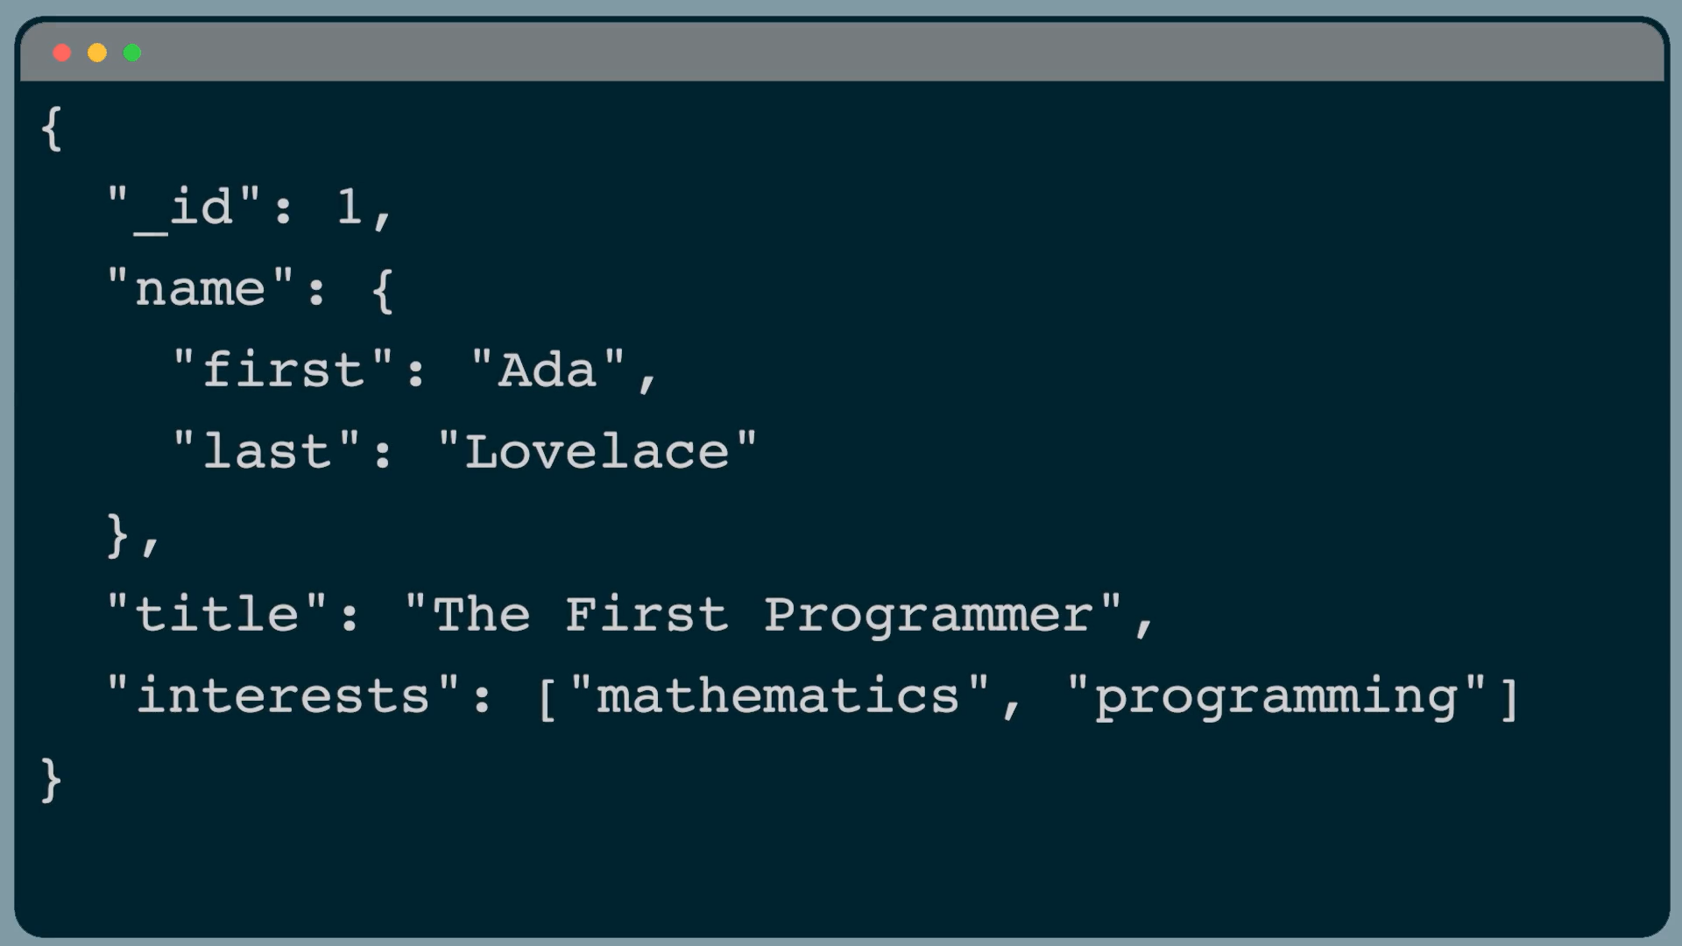

Slide 40


Slide 41


Slide 42


Slide 43


Slide 44


Slide 45


Slide 46


Slide 47


Slide 48
Data Modeling

Slide 49
Documents
Data Types
Flexible schema Model

Slide 50
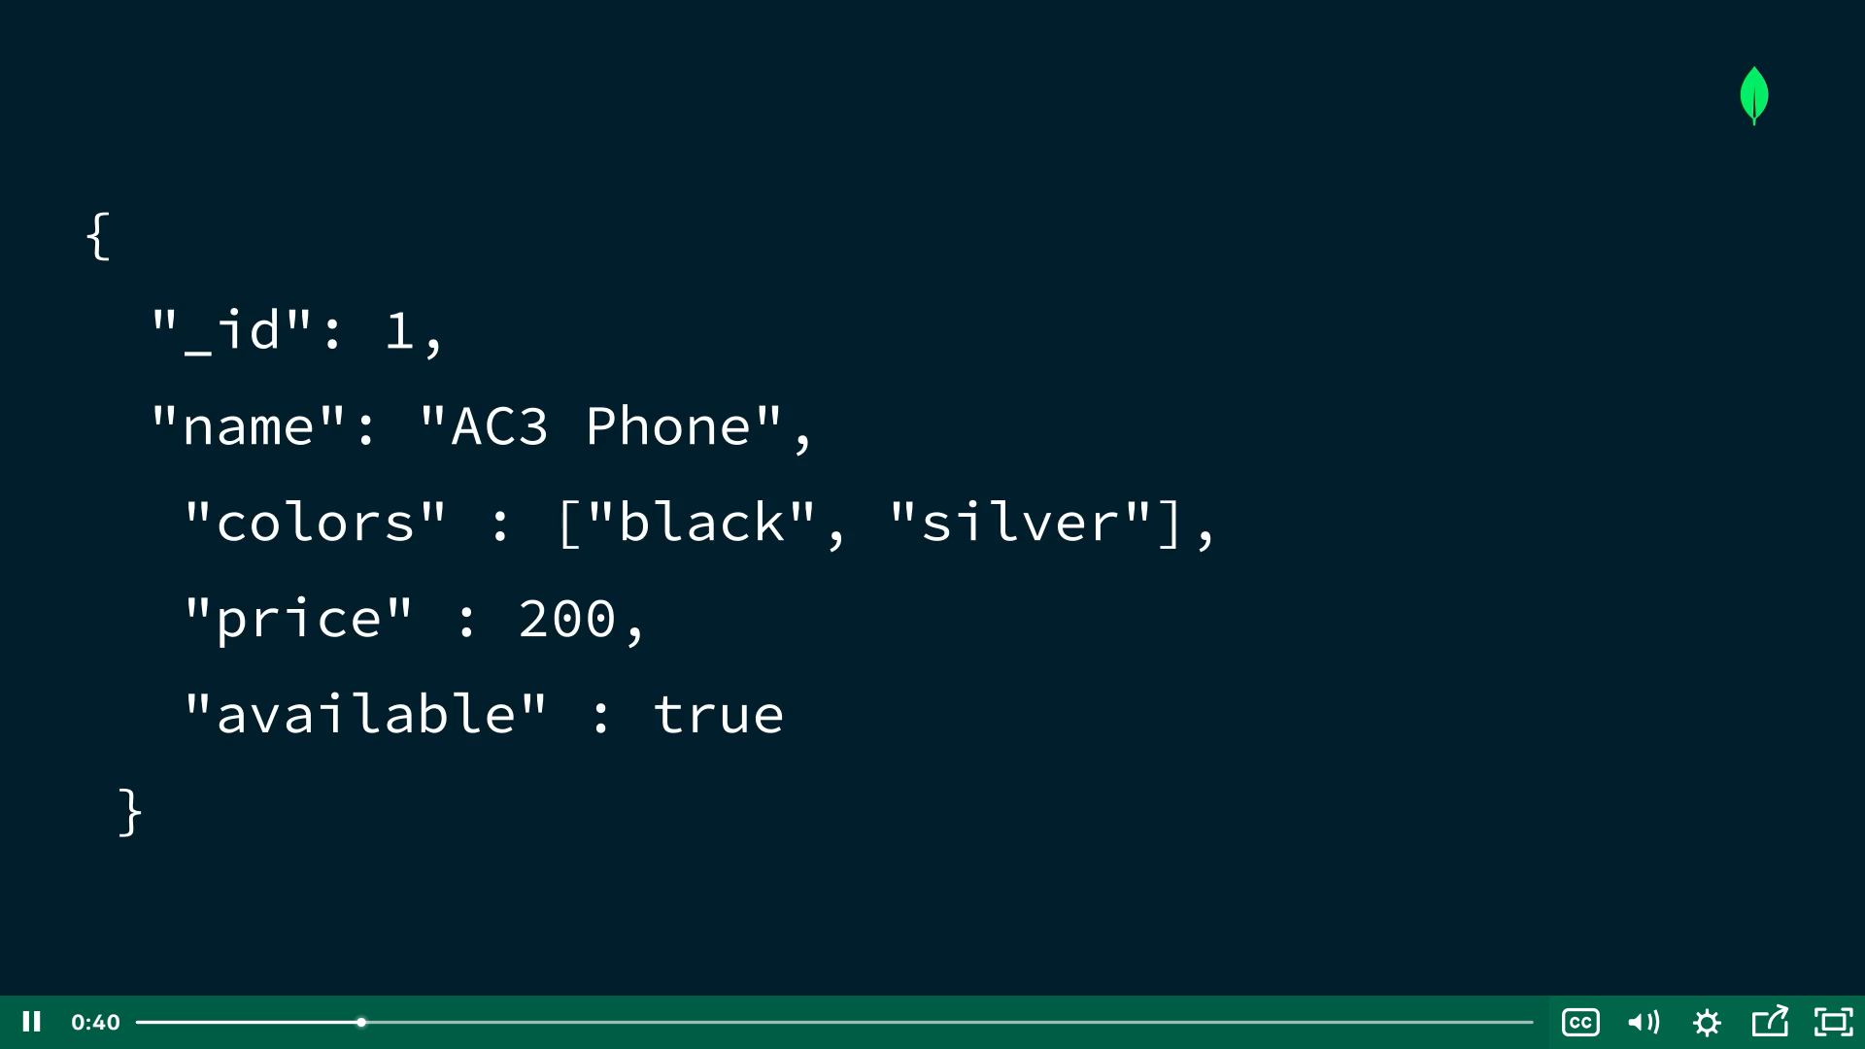

Slide 51
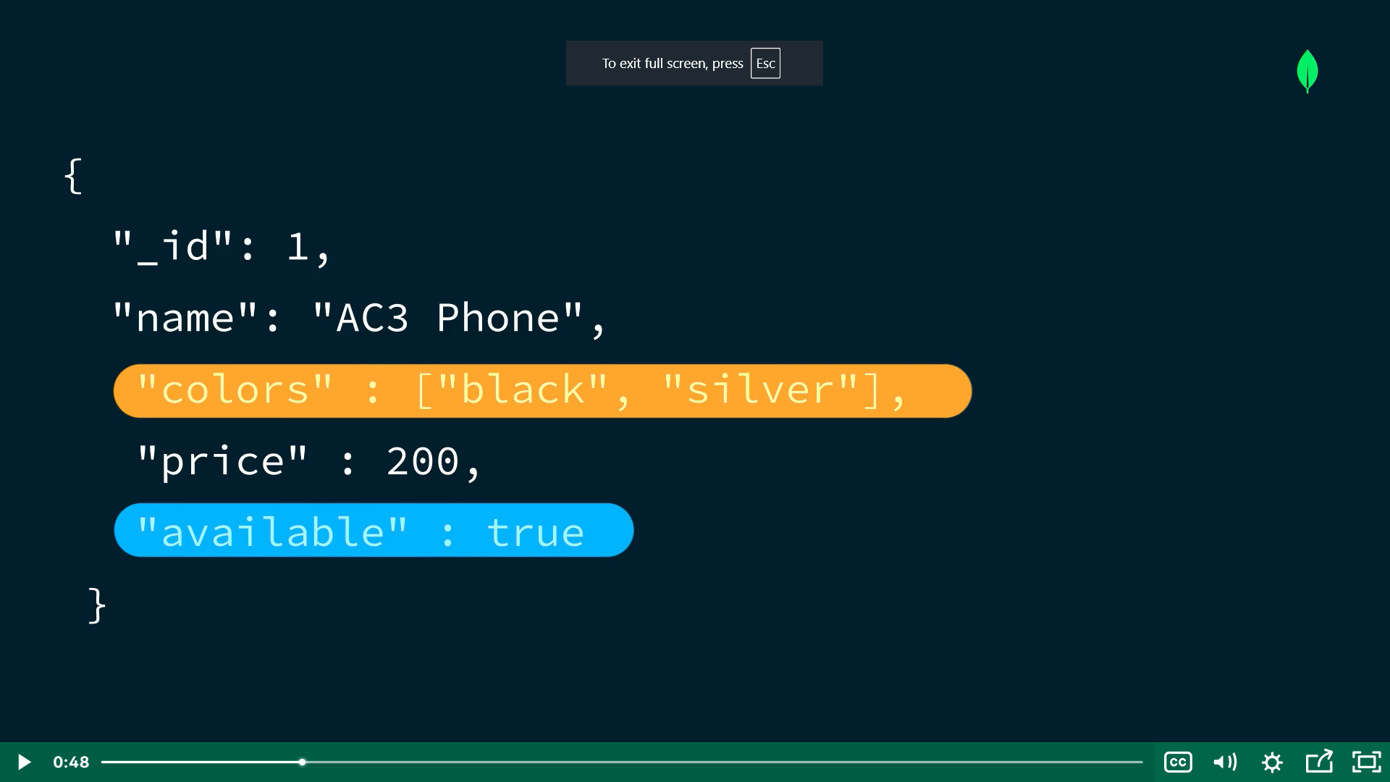

Slide 52
Displayed in JSON
Stored in BSON
BSON is a binary encoded Javascript Object Notation (JSON)—a textual object notation widely used to transmit and store data across web based applications. JSON is easier to understand as it is human-readable, but compared to BSON, it supports fewer data types.

Slide 53


Slide 54


Slide 55



Slide 56


Slide 57
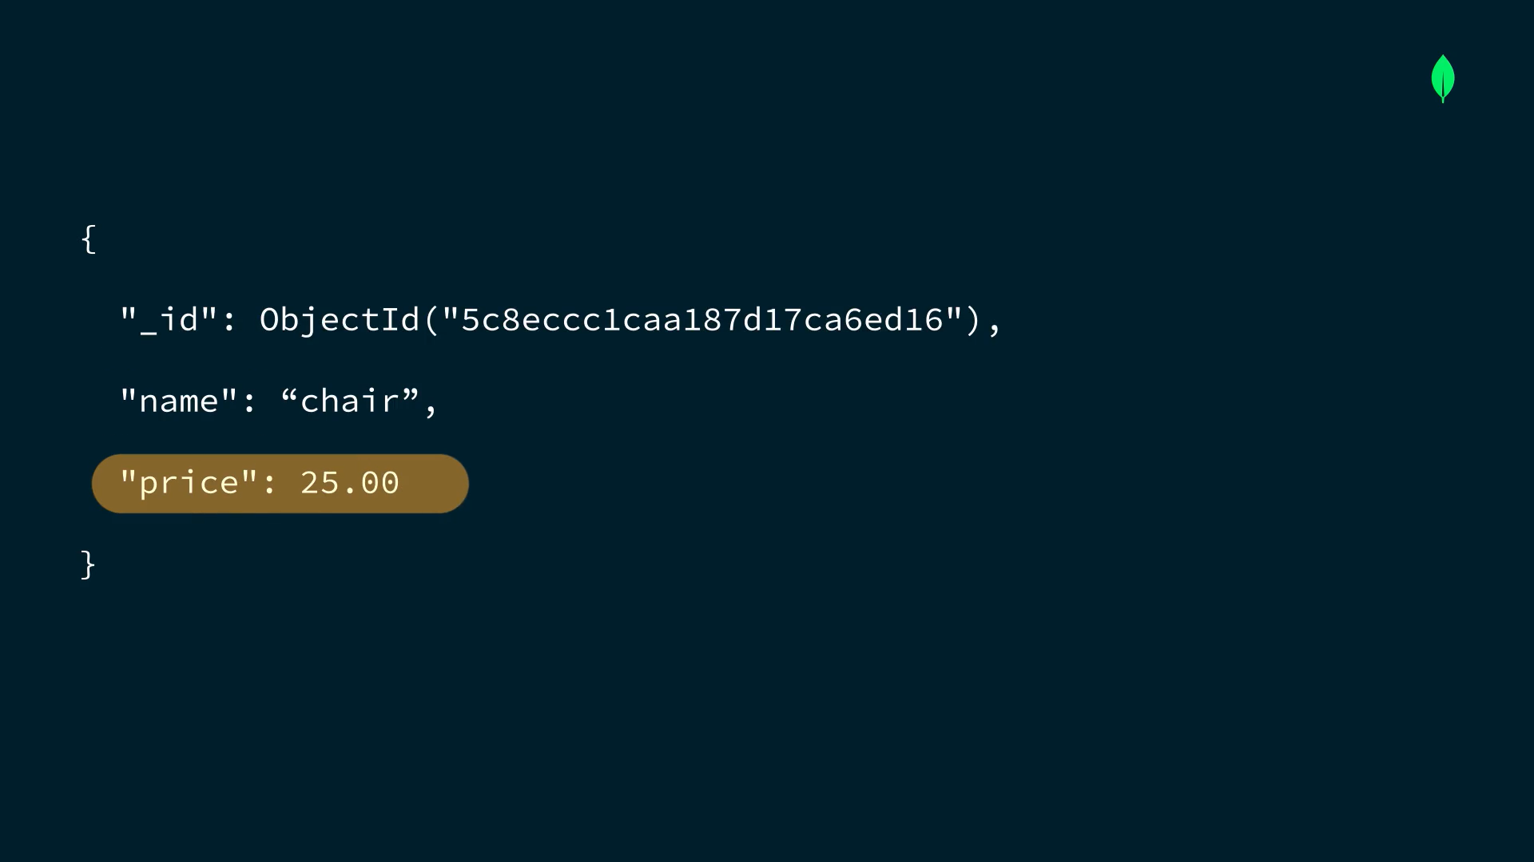

Slide 58
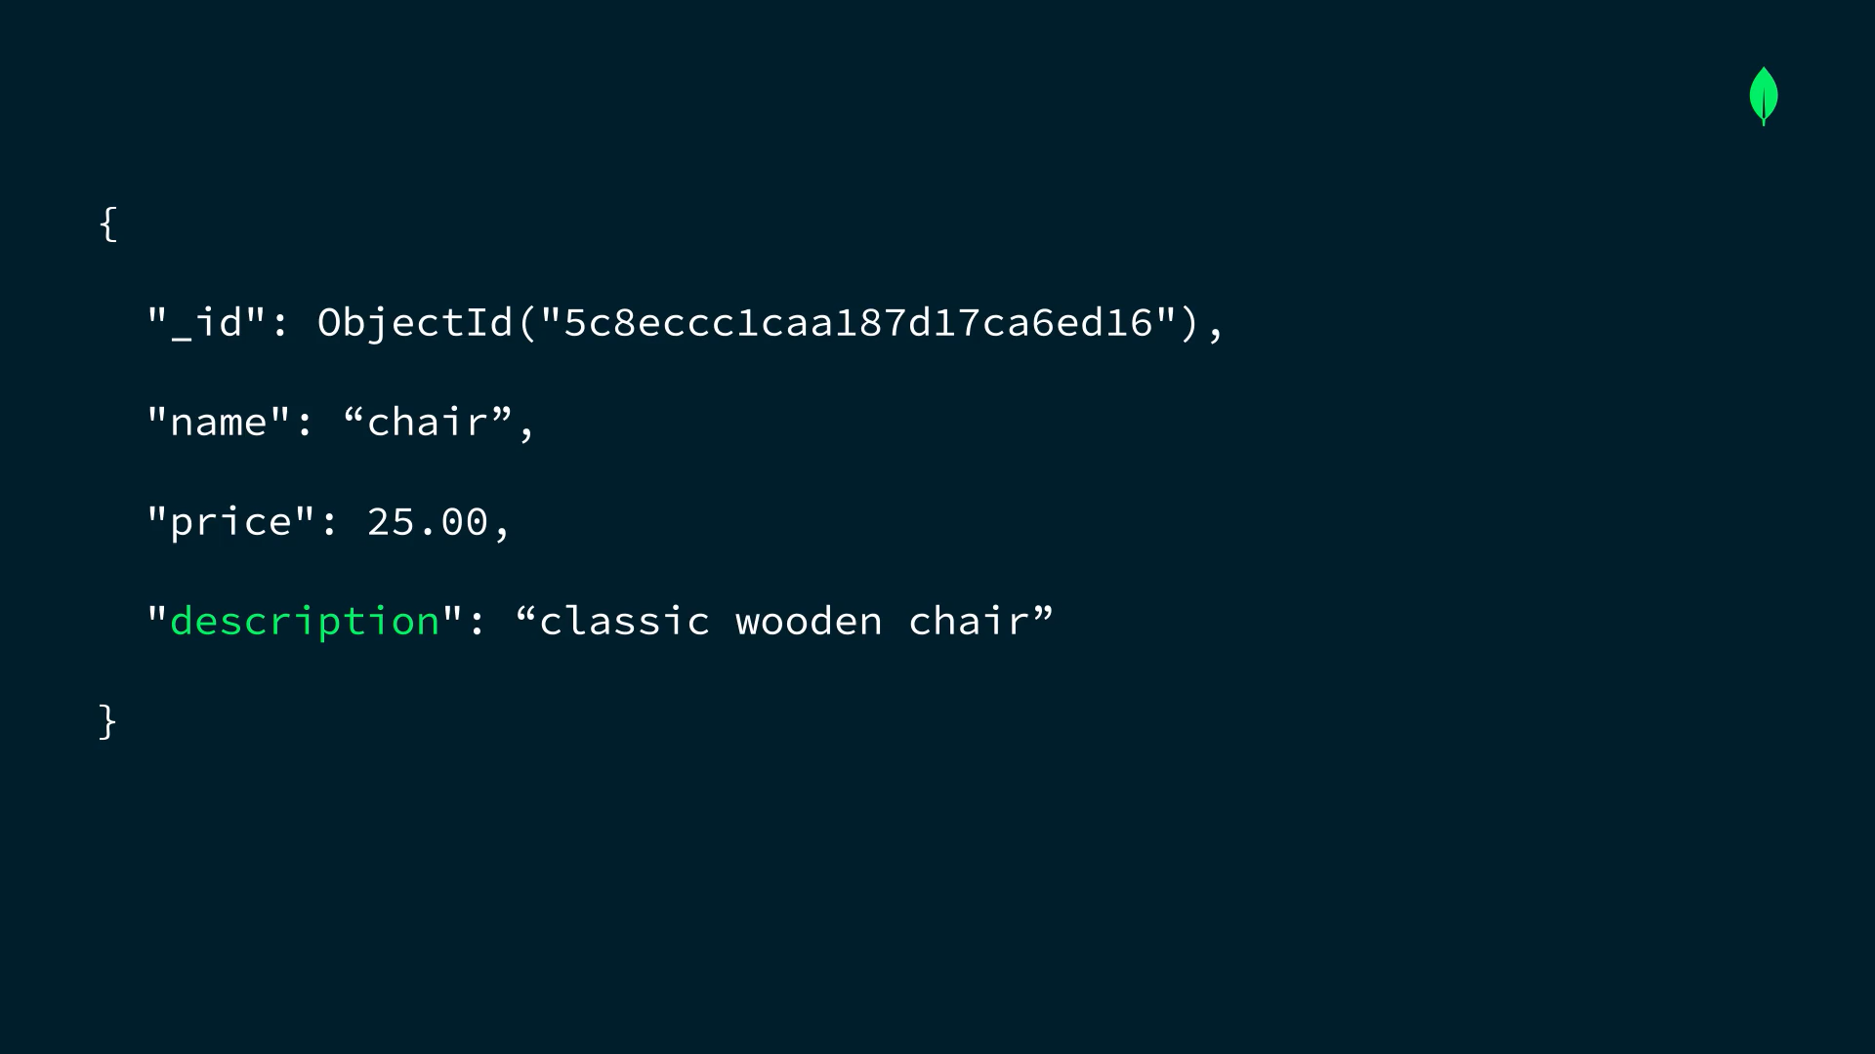

Slide 59


Slide 60


Slide 61


Slide 62
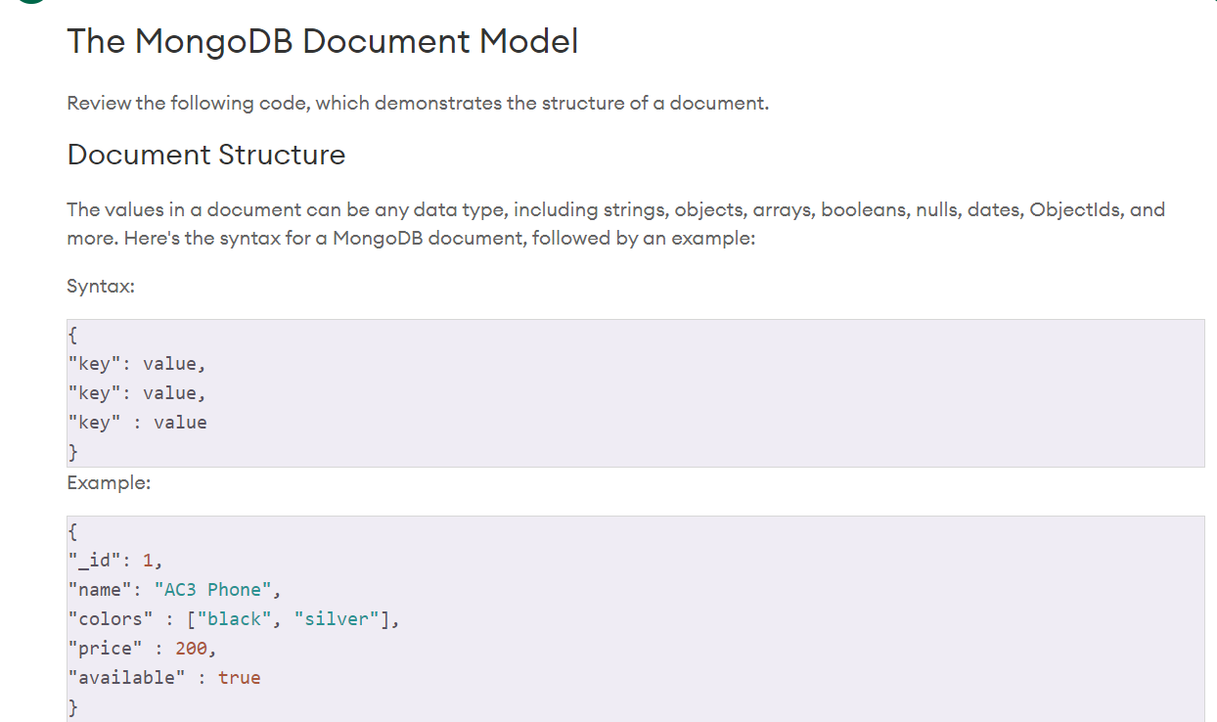

Slide 63
Data Modeling

Slide 64
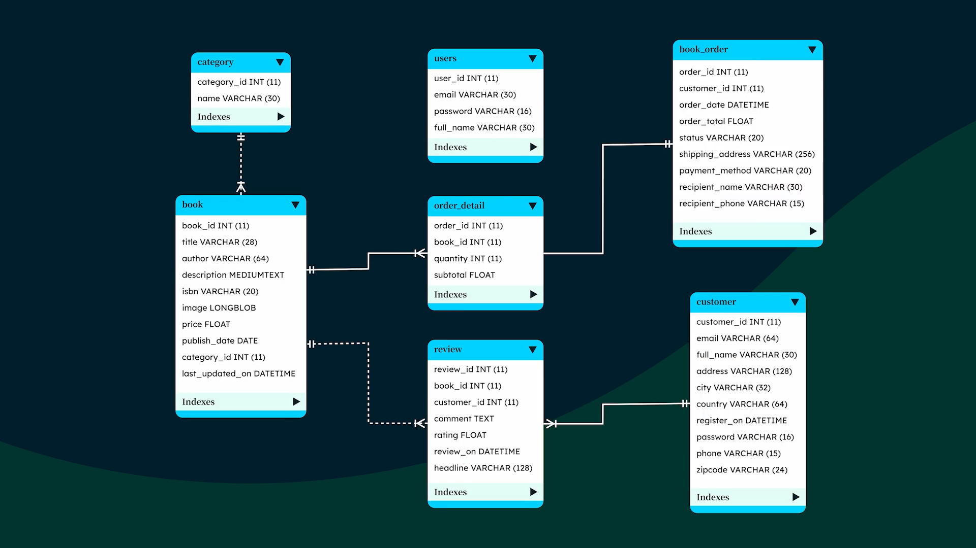

Slide 65
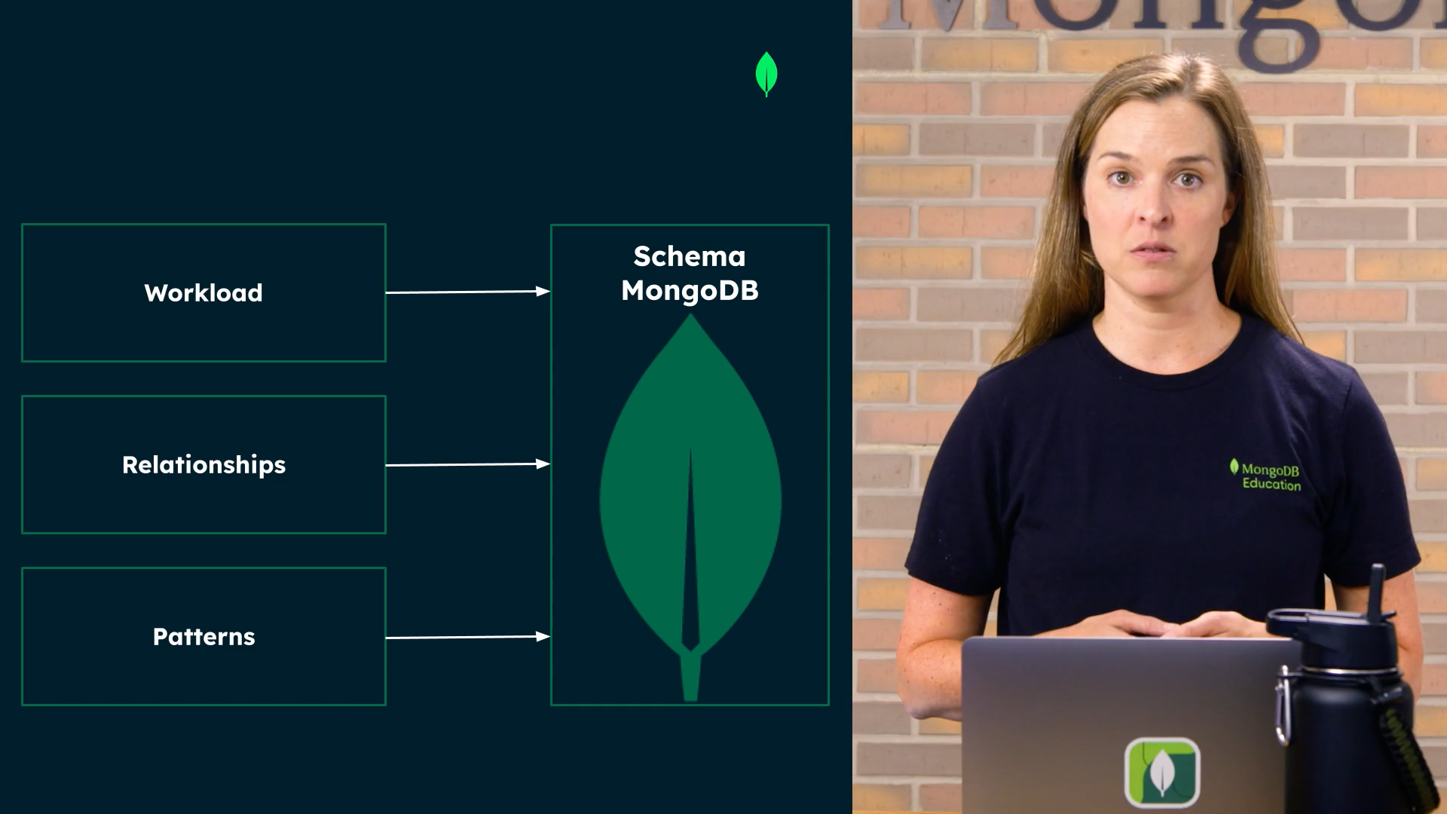

Slide 66


Slide 67
Work Load
Identify Application Workload
The first step in the schema design process is to identify the operations that your application runs most frequently. Knowing your application's most common queries helps you create effective indexes and minimize the number of calls the application makes to the database.

Slide 68
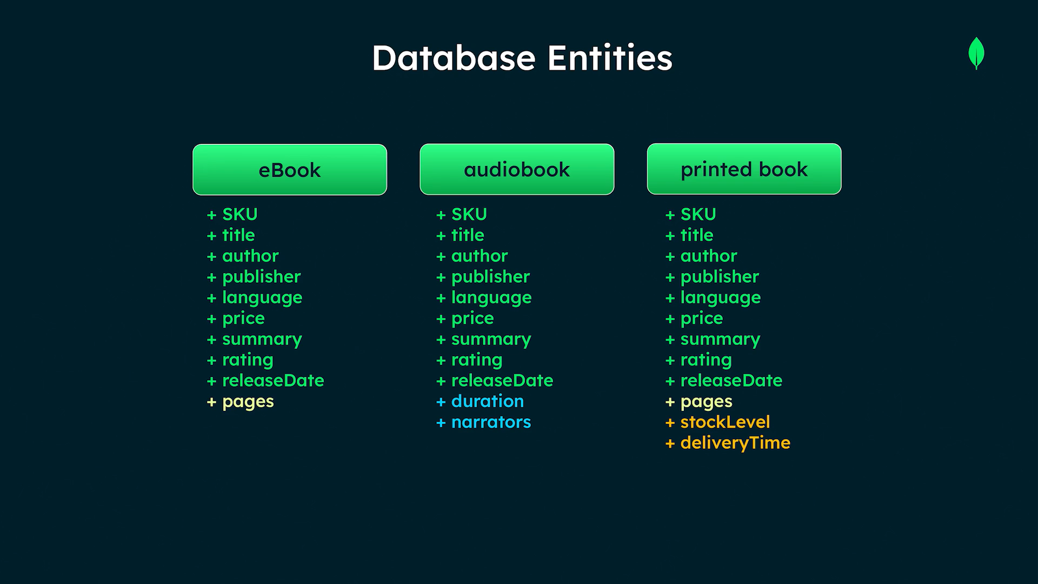

Slide 69
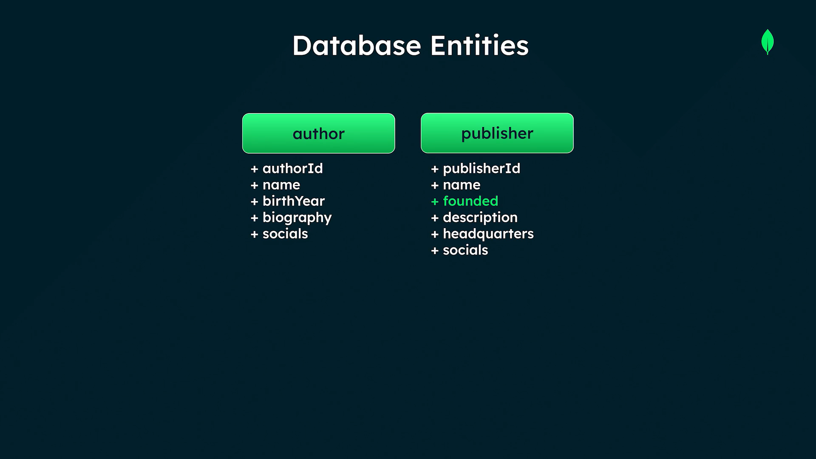

Slide 70
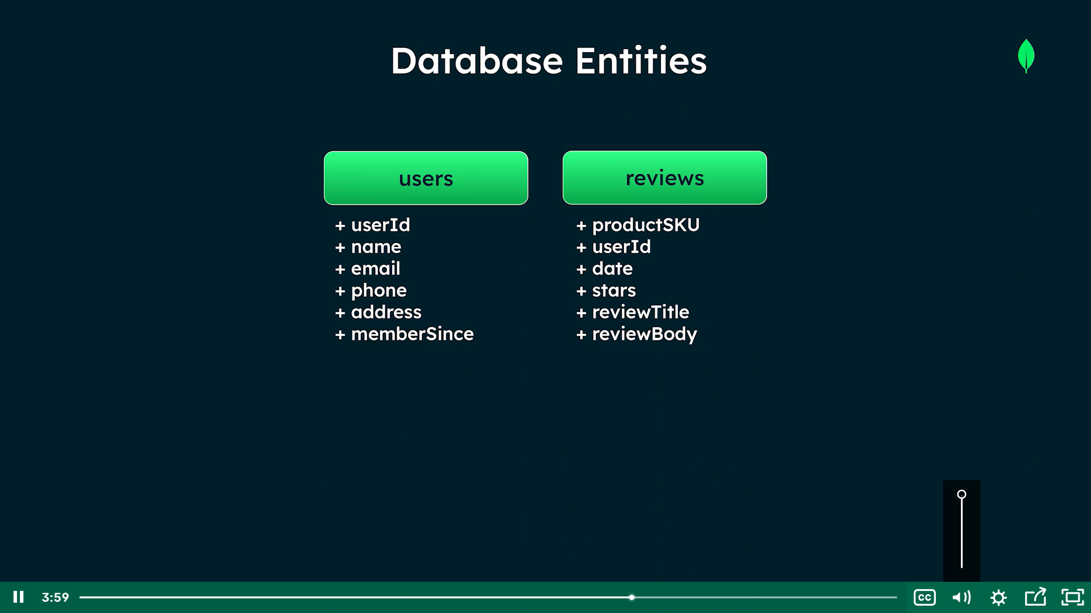

Slide 71


Slide 72
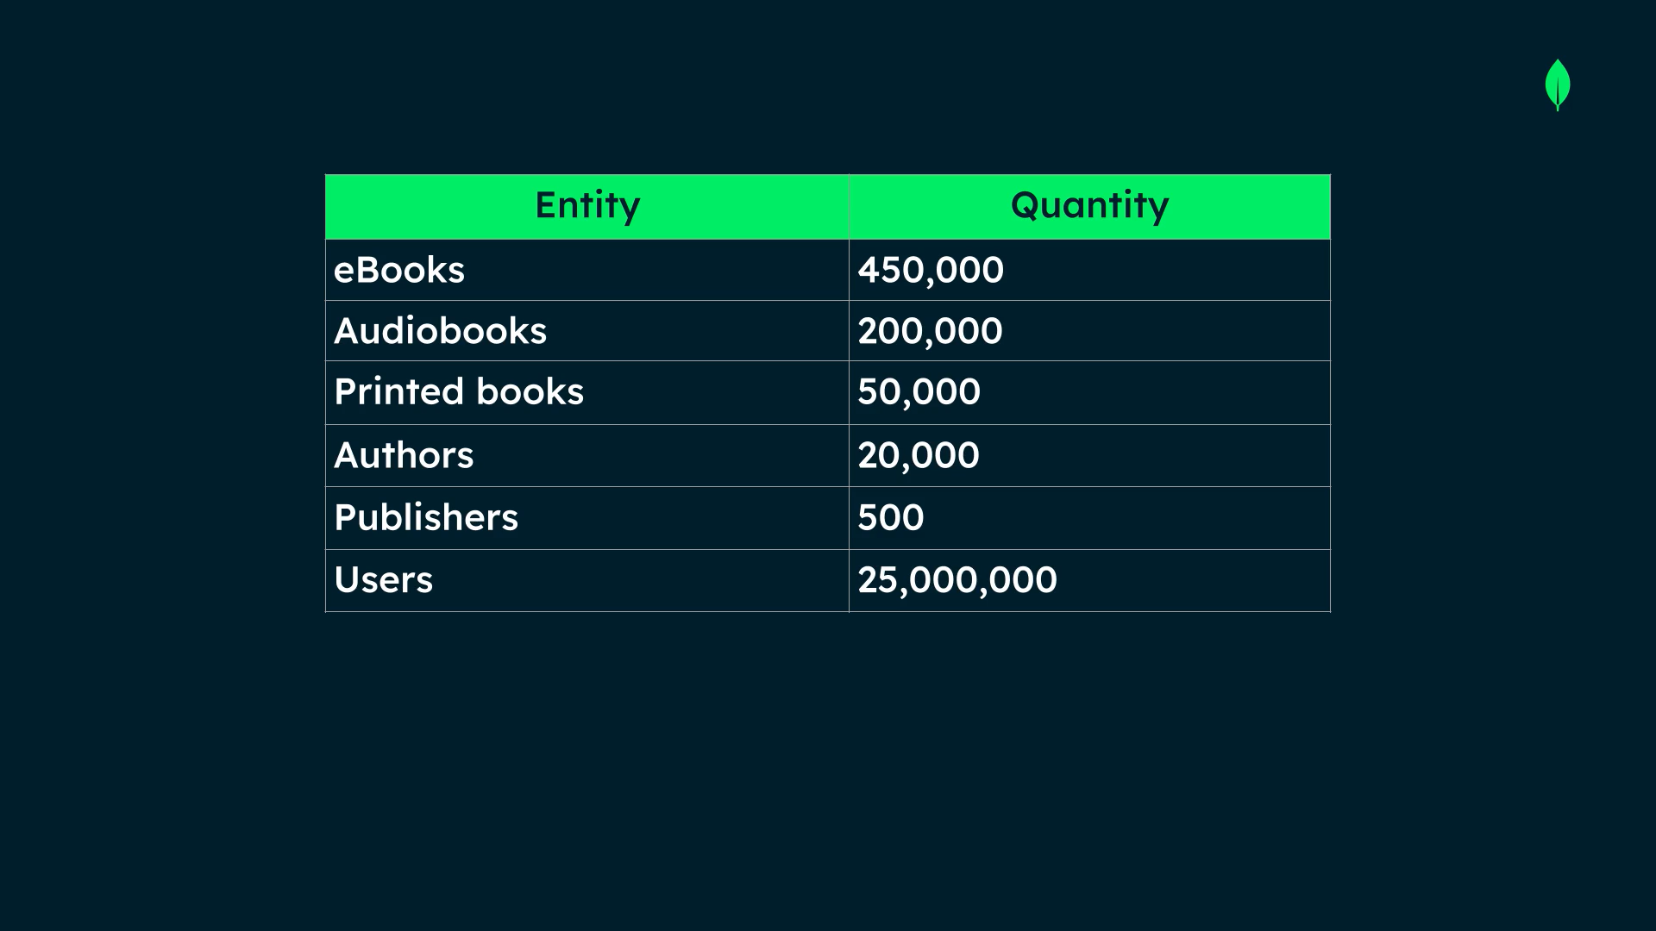

Slide 73
Relationships

Slide 74
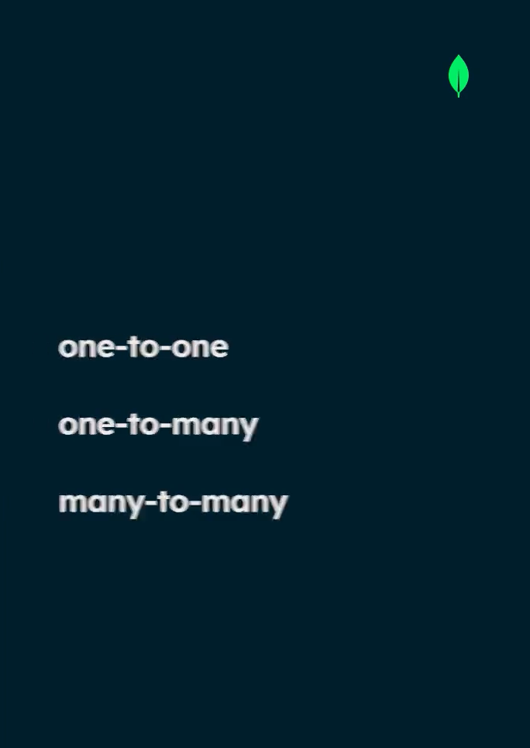

Slide 75
Relationship types
Embedding
References

Slide 76
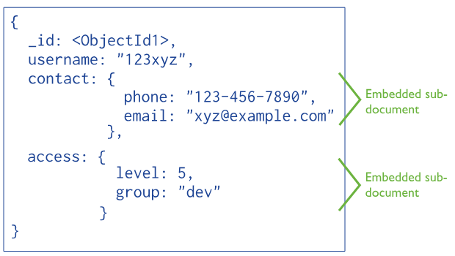

Slide 77
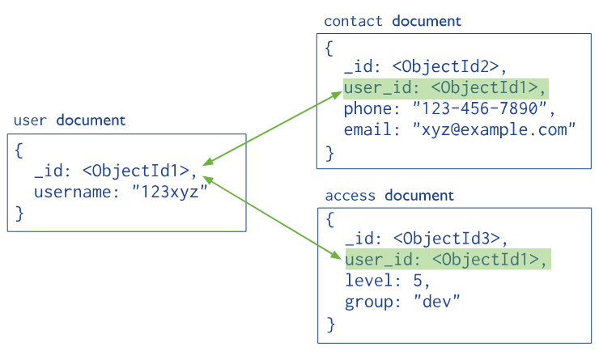

Slide 78
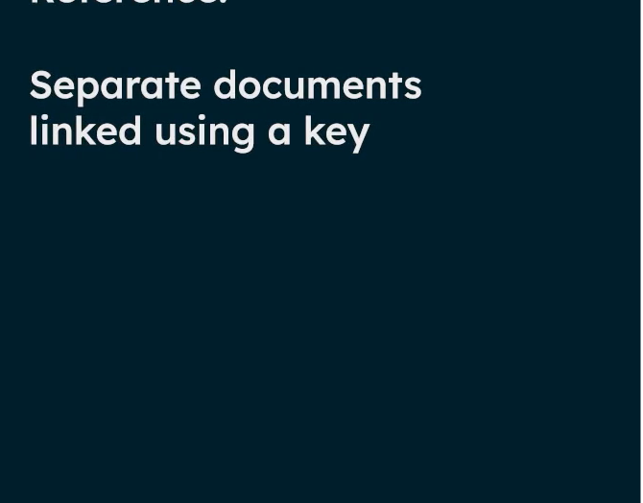
References

Slide 79
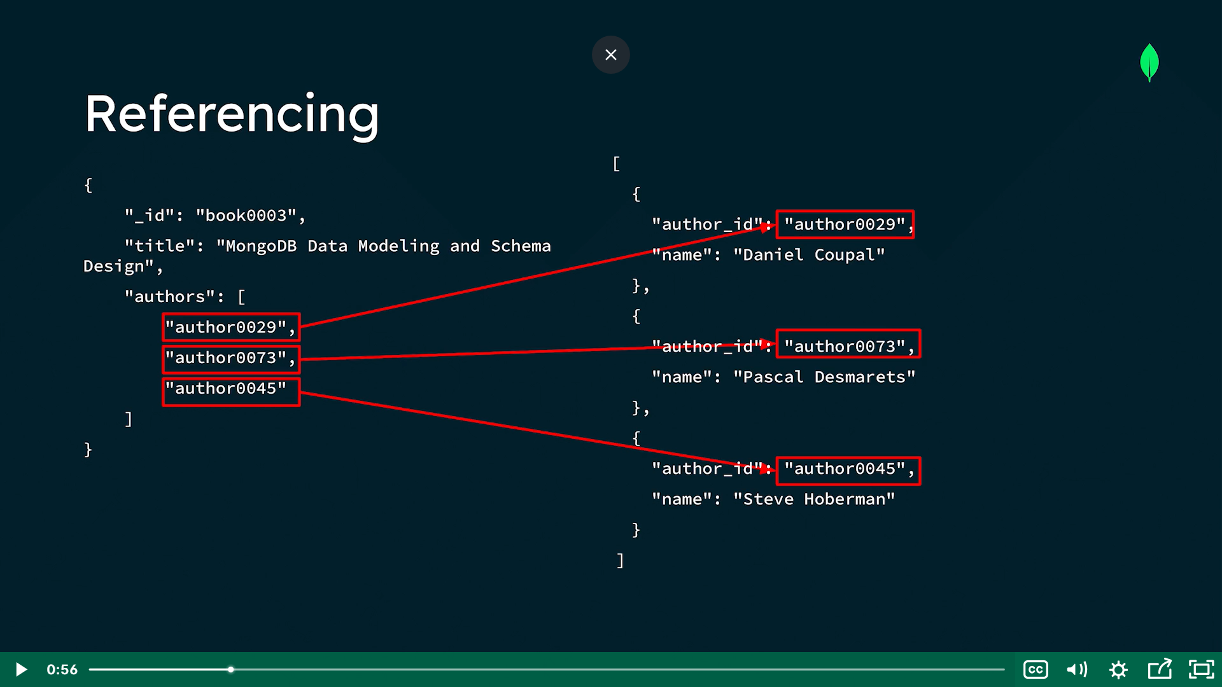

Slide 80
